Slide 1


運動專業英語
English for Athletes

Slide 2
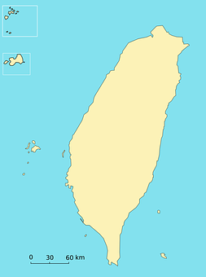
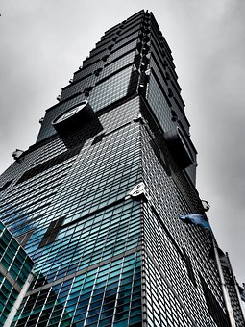
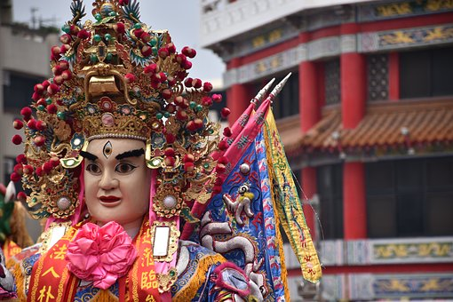
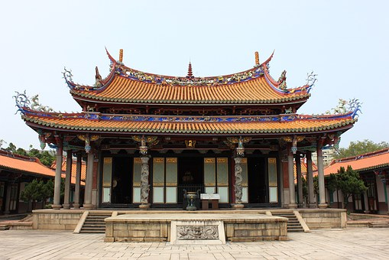
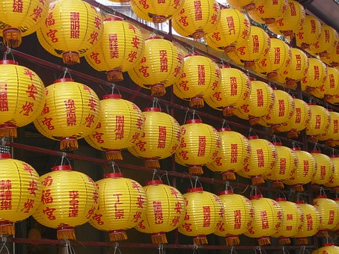
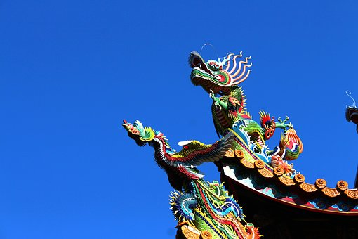
Lesson 1: I’m From Taiwan

Slide 3
運動專業英語
English for Athletes
Lesson 1: I’m From Taiwan
Part 1: Dialogue 1

Slide 4
Dialogue 1 (the situation)
Allen Johnson is a Canadian tennis player. Grace Chen is a tennis player from Taiwan. They are both participating in a tournament in the U.S.

Slide 5
Dialogue 1 (1/4)
Allen: Hi, how are you? I’m Allen
Johnson.
Grace: Hi, I’m Grace Chen. Nice to
meet you.

Slide 6
Dialogue 1 (2/4)
Allen: Nice to meet you, too. I’m
from Canada. What about
you?
Grace: I’m from Taiwan. I major in
Physical Education at
National Taiwan Normal
University.

Slide 7
Dialogue 1 (3/4)
Allen: Really? You’re from Taiwan.
That’s so cool!
Grace: Have you heard of Taiwan
before?
Allen: Yes, I’ve heard that it’s a
beautiful country.

Slide 8
Dialogue 1 (4/4)
Grace: It really is. Taiwan is
famous for its beautiful
scenery.
Allen: I really hope I can go to
Taiwan sometime.
Grace: You really should. I’ll be
happy to show you
around.

Slide 9
Dialogue 1 – Vocabulary & Phrases
tennis (網球)
participating in (參與/參加)
tournament (比賽)
Physical Education (體育)
be famous for (因...而出名)
scenery (風景/景色)
to show somebody around (帶某人走走看看)

Slide 10
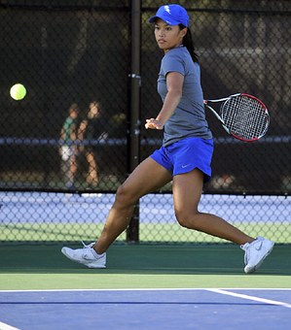
Vocabulary & Phrases—Practice
tennis (網球)
Taiwan has several tennis players who will play in the US Open this year.

Slide 11
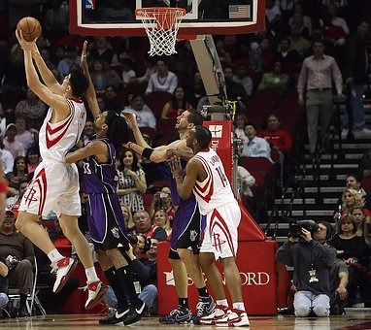
Vocabulary & Phrases—Practice
participating in (參與/參加)
The team is participating in the high school basketball tournament.

Slide 12
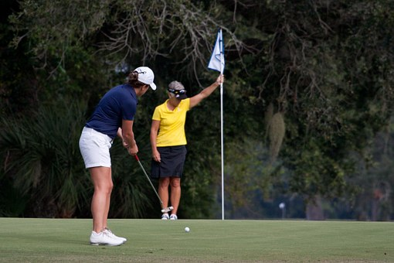
Vocabulary & Phrases—Practice
tournament (比賽)
The coaches think he is good enough to enter the golf tournament.

Slide 13

Vocabulary & Phrases—Practice
Physical Education (體育)
Carol wants to major in Physical Education when she goes to college.

Slide 14
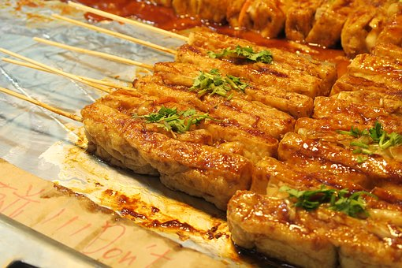
Vocabulary & Phrases—Practice
be famous for (因...而出名)
Shen-keng is famous for its stinky tofu.

Slide 15
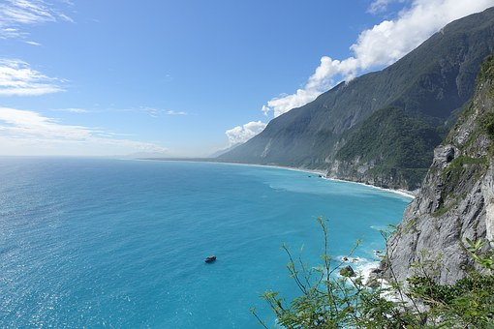
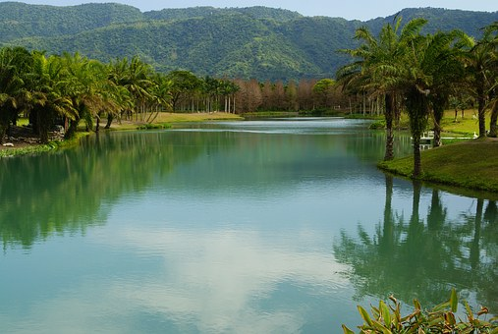
Vocabulary & Phrases—Practice
scenery (風景/景色)
The scenery in Hualien is very beautiful.

Slide 16

Vocabulary & Phrases—Practice
to show somebody around (帶某人走走看看)
Let me know when you will arrive in Taiwan. I will be happy to show you around.

Slide 17
運動專業英語
English for Athletes
Lesson 1: I’m From Taiwan
Part 1: Dialogue 1
Read each of the sentences two times.

Slide 18
Vocabulary & Phrases—Practice
tennis (網球)
Taiwan has several tennis players who will play in the US Open this year.

Slide 19
Vocabulary & Phrases—Practice
participating in (參與/參加)
The team is participating in the high school basketball tournament.

Slide 20
Vocabulary & Phrases—Practice
tournament (比賽)
The coaches think he is good enough to enter the golf tournament.

Slide 21
Vocabulary & Phrases—Practice
Physical Education (體育)
Carol wants to major in Physical Education when she goes to college.

Slide 22
Vocabulary & Phrases—Practice
be famous for (因...而出名)
Shen-keng is famous for its stinky tofu.

Slide 23
Vocabulary & Phrases—Practice
scenery (風景/景色)
The scenery in Hualien is very beautiful.

Slide 24
Vocabulary & Phrases—Practice
to show somebody around (帶某人走走看看)
Let me know when you will arrive in Taiwan. I will be happy to show you around.

Slide 25
運動專業英語
English for Athletes
Lesson 1: I’m From Taiwan
This is the end of Lesson 1,
Part 1

