Slide 1


運動專業英語
English for Athletes

Slide 2
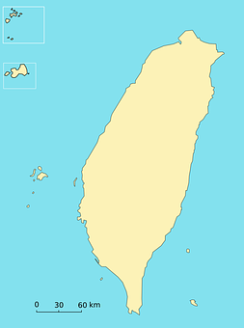

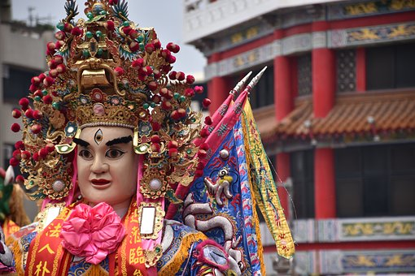

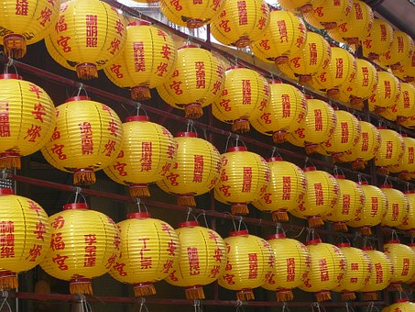

Lesson 1: I’m From Taiwan

Slide 3
運動專業英語
English for Athletes
Lesson 1: I’m From Taiwan
Part 2: Dialogue 2

Slide 4
Dialogue 2 (the situation)
Allen and Grace meet each other after they finish practicing.

Slide 5
Dialogue 2 (1/5)
Allen: Do you have a match this
evening?
Grace: Yes, at 7:00 p.m. I’m a
little nervous. My
opponent has a great
serve.

Slide 6
Dialogue 2 (2/5)
Allen: I’m sure you will do well. I
saw you practicing. You
have a great forehand and
backhand.
Grace: Thank you.

Slide 7
Dialogue 2 (3/5)
Allen: I need to go meet my
coach. I hope to see you
again. I saw on the
schedule you are playing
singles, doubles, and
mixed doubles.

Slide 8
Dialogue 2 (4/5)
Grace: Yes, what about you?
Allen: I’m playing singles and
doubles, too. So I’m sure
we will meet each other
again. I need to go to the
locker room now.

Slide 9
Dialogue 2 (5/5)
Grace: Okay. Hope we can chat
again.
Allen: Good luck tonight, Grace.
Grace: Thanks, Allen. See you later.
Allen: Bye.

Slide 10
Dialogue 2 – Vocabulary & Phrases
match (比賽)
opponent (對手)
serve (發球)
forehand (正手)
backhand (反手)
coach (教練)

Slide 11
Dialogue 2 – Vocabulary & Phrases
schedule (賽程)
singles (單打)
doubles (雙打)
mixed doubles (混雙雙打)
locker room (更衣室)
to chat (聊天)

Slide 12

Vocabulary & Phrases—Practice
match (比賽)
David will have two tennis matches this weekend.

Slide 13
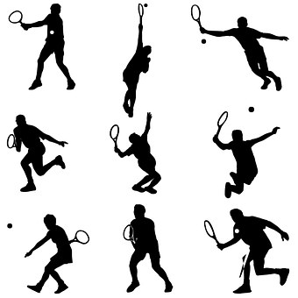
Vocabulary & Phrases—Practice
opponent (對手)
Who is your opponent in the tournament tomorrow?

Slide 14
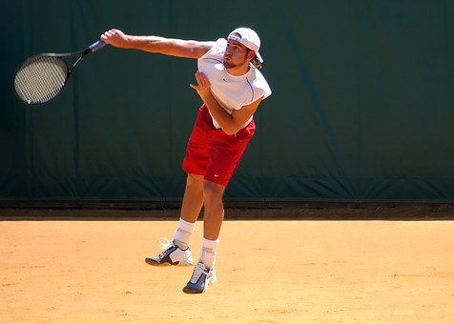
Vocabulary & Phrases—Practice
serve (發球)
He has a very powerful serve.

Slide 15
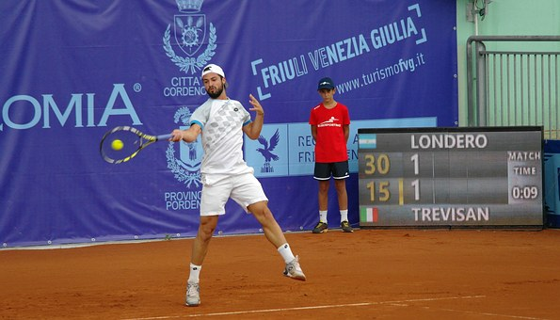
Vocabulary & Phrases—Practice
forehand (正手)
That forehand shot down the line was impossible to return.

Slide 16
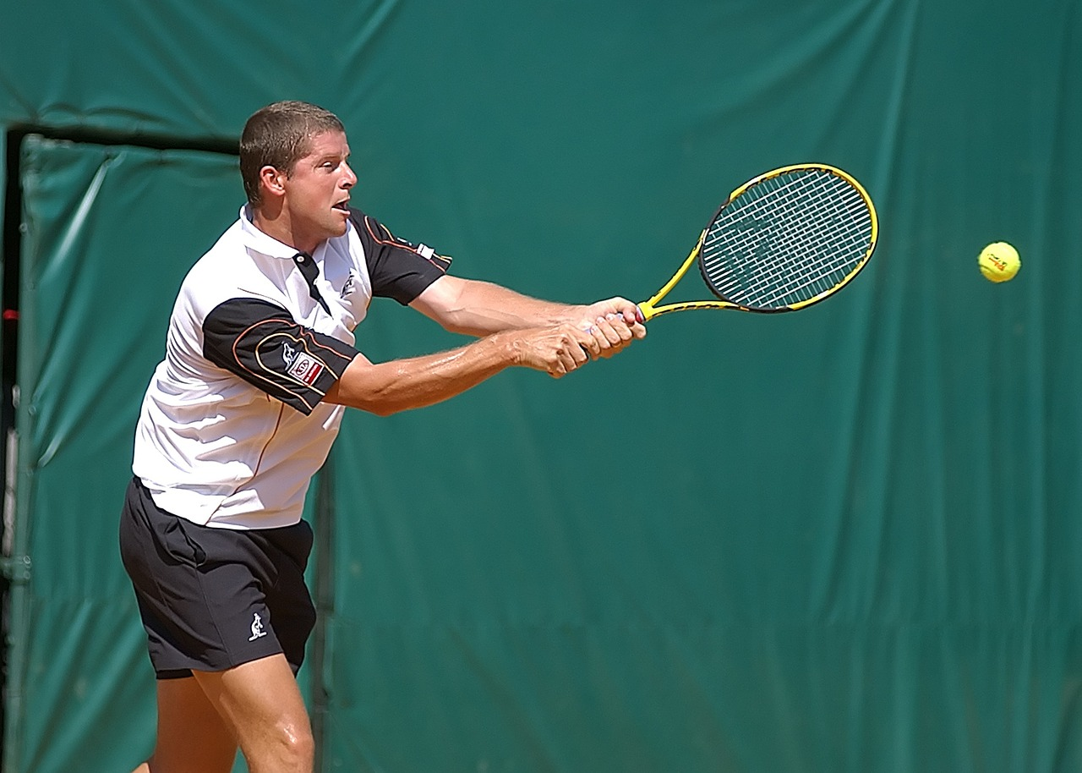
Vocabulary & Phrases—Practice
backhand (反手)
Many people admire his backhand.

Slide 17
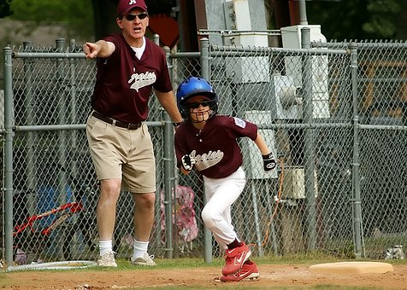
Vocabulary & Phrases—Practice
coach (教練)
The coach is very strict.

Slide 18
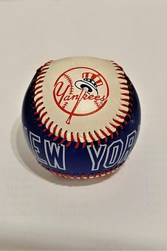

Vocabulary & Phrases—Practice
schedule (賽程)
The Yankees have a difficult schedule this month. They will go on a ten-game road trip.

Slide 19
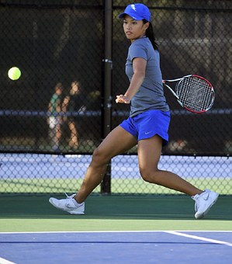
Vocabulary & Phrases—Practice
singles (單打)
She is the top singles player on her high school tennis team.

Slide 20
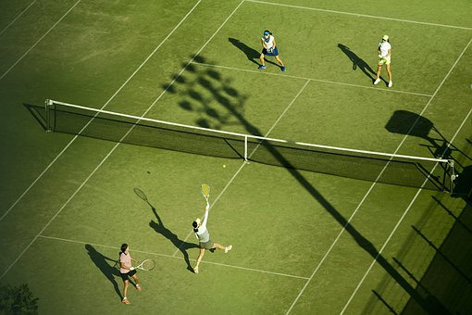
Vocabulary & Phrases—Practice
doubles (雙打)
The two sisters will compete in the doubles tournament.

Slide 21
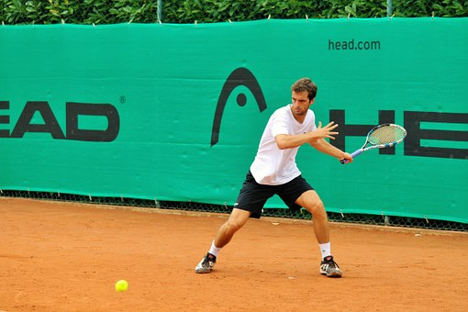
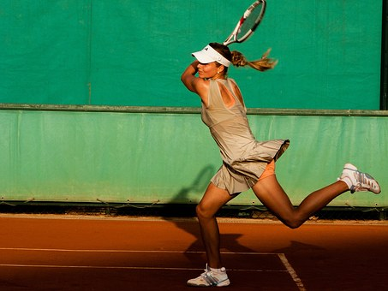
Vocabulary & Phrases—Practice
mixed doubles (混雙雙打)
Kevin is looking for a partner to play mixed doubles.

Slide 22
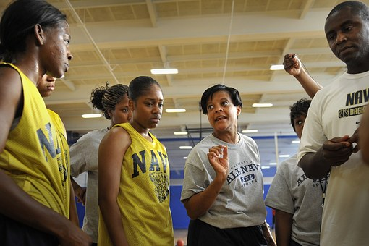
Vocabulary & Phrases—Practice
locker room (更衣室)
The coach is talking to the players in the locker room.

Slide 23

Vocabulary & Phrases—Practice
to chat (聊天)
Lucy is so busy training that she doesn’t have time to chat with her friends.

Slide 24
運動專業英語
English for Athletes
Lesson 1: I’m From Taiwan
Part 2: Dialogue 2

Slide 25
運動專業英語
English for Athletes
Lesson 1: I’m From Taiwan
Part 2: Dialogue 2
Read each of the sentences two times.

Slide 26
Vocabulary & Phrases—Practice
match (比賽)
David will have two tennis matches this weekend.

Slide 27
Vocabulary & Phrases—Practice
opponent (對手)
Who is your opponent in the tournament tomorrow?

Slide 28
Vocabulary & Phrases—Practice
serve (發球)
He has a very powerful serve.

Slide 29
Vocabulary & Phrases—Practice
forehand (正手)
That forehand shot down the line was impossible to return.

Slide 30
Vocabulary & Phrases—Practice
backhand (反手)
Many people admire his backhand.

Slide 31
Vocabulary & Phrases—Practice
coach (教練)
The coach is very strict.

Slide 32
Vocabulary & Phrases—Practice
schedule (賽程)
The Yankees have a difficult schedule this month. They will go on a ten-game road trip.

Slide 33
Vocabulary & Phrases—Practice
singles (單打)
She is the top singles player on her high school tennis team.

Slide 34
Vocabulary & Phrases—Practice
doubles (雙打)
The two sisters will compete in the doubles tournament.

Slide 35
Vocabulary & Phrases—Practice
mixed doubles (混雙雙打)
Kevin is looking for a partner to play mixed doubles.

Slide 36
Vocabulary & Phrases—Practice
locker room (更衣室)
The coach is talking to the players in the locker room.

Slide 37
Vocabulary & Phrases—Practice
to chat (聊天)
Lucy is so busy training that she doesn’t have time to chat with her friends.

Slide 38
運動專業英語
English for Athletes
Lesson 1: I’m From Taiwan
This is the end of Lesson 1,
Part 2.

