Slide 1


運動專業英語
English for Athletes

Slide 2
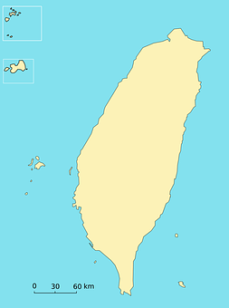
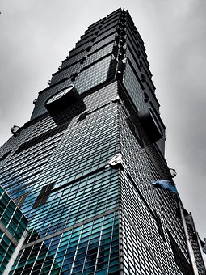
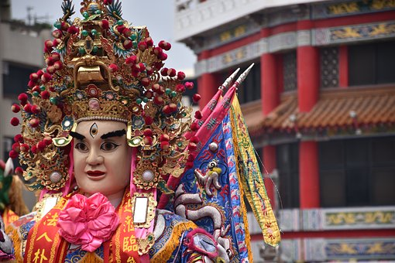
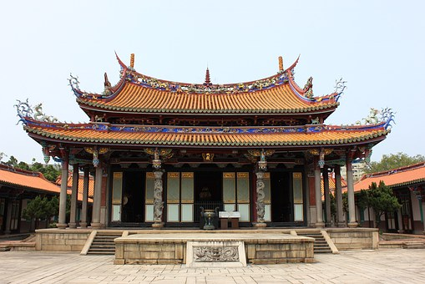
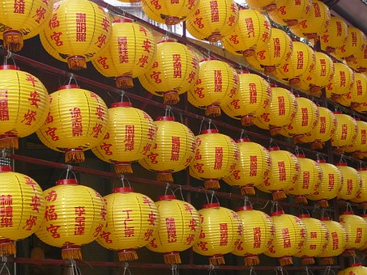
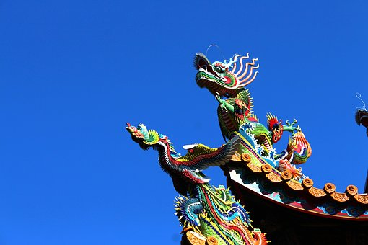
Lesson 1: I’m From Taiwan

Slide 3
運動專業英語
English for Athletes
Lesson 1: I’m From Taiwan
Part 3: Culture Notes

Slide 4
Culture Note:
Grand Slam Tennis Tournaments
There are four major tennis tournaments each year. They are called Grand Slam tennis tournaments.
Australian Open—Melbourne, Australia
French Open—Paris, France
Wimbledon—Wimbledon, London,
England
U.S. Open—New York, USA

Slide 5
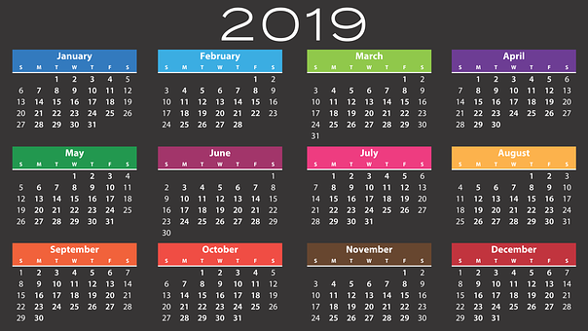
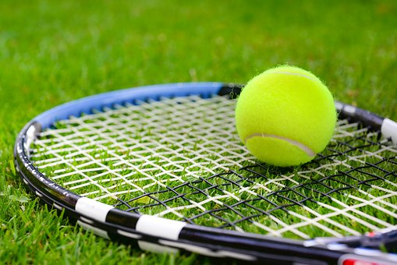
Culture Note:
Grand Slam Tennis Tournaments
The four Grand Slam tennis tournaments are held in different months of the year.

Slide 6
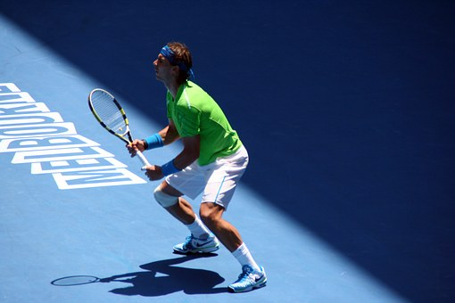
Culture Note:
Grand Slam Tennis Tournaments
The Australian Open is held during late January. It is summertime in Australia then.

Slide 7
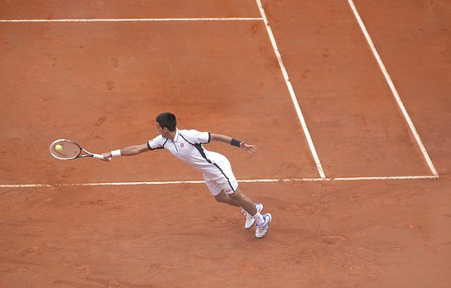
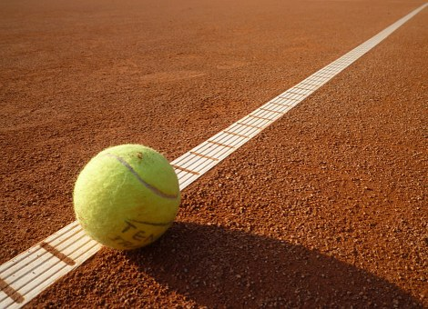
Culture Note:
Grand Slam Tennis Tournaments
The French Open takes place from late May to the middle of June.

Slide 8
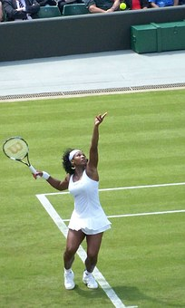
Culture Note:
Grand Slam Tennis Tournaments
Wimbledon begins at the end of June and continues into July. All the players are required to wear white tennis clothes.

Slide 9
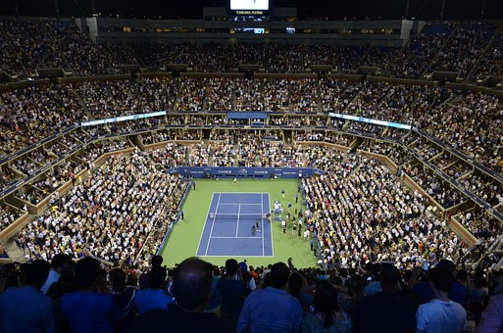
Culture Note:
Grand Slam Tennis Tournaments
The US Open is held in New York City in August and September. It is the last Grand Slam tennis tournament of the year.

Slide 10
Culture Note:
Grand Slam Tennis Tournaments
Court Surface
Australian Open—hard courts
French Open—clay courts
Wimbledon—grass courts
U.S. Open—hard courts

Slide 11
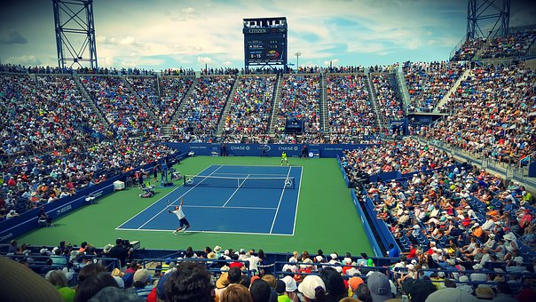
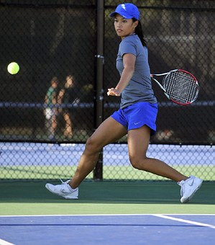
Hard Tennis Court

Slide 12
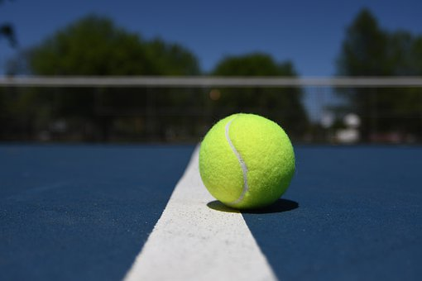
Culture Note:
Grand Slam Tennis Tournaments
Court Surface
The Australian Open and the U.S. Open are played on hard courts.

Slide 13
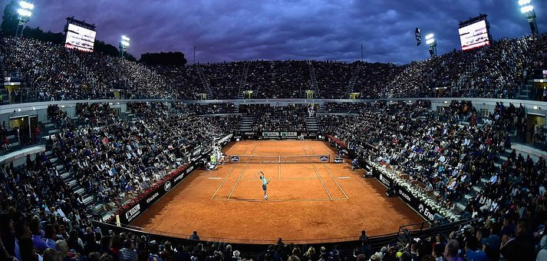
Clay Tennis Court

Slide 14
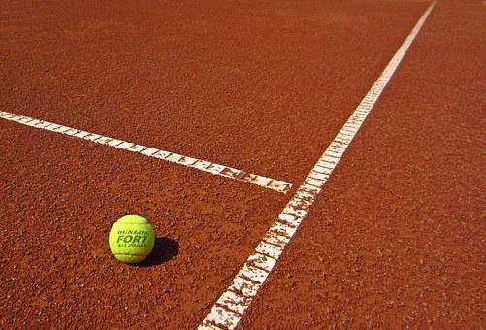
Culture Note:
Grand Slam Tennis Tournaments
Court Surface
The French Open is played on clay courts.

Slide 15
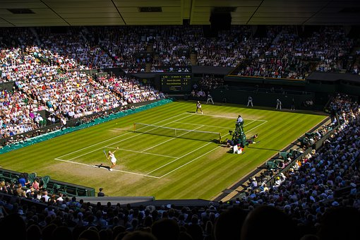
Grass Tennis Court

Slide 16
Culture Note:
Grand Slam Tennis Tournaments
Court Surface
Wimbledon is played on grass courts.

Slide 17
運動專業英語
English for Athletes
Lesson 1: I’m From Taiwan
Part 3
Read each of the sentences two times.

Slide 18
Culture Note:
Grand Slam Tennis Tournaments
The Australian Open is held during late January. It is summertime in Australia then.

Slide 19
Culture Note:
Grand Slam Tennis Tournaments
The French Open takes place from late May to the middle of June.

Slide 20
Culture Note:
Grand Slam Tennis Tournaments
Wimbledon begins at the end of June and continues into July. All the players are required to wear white tennis clothes.

Slide 21
Culture Note:
Grand Slam Tennis Tournaments
The US Open is held in New York City in August and September. It is the last Grand Slam tennis tournament of the year.

Slide 22
Culture Note:
Grand Slam Tennis Tournaments
Court Surface
The Australian Open and the U.S. Open are played on hard courts.

Slide 23
Culture Note:
Grand Slam Tennis Tournaments
Court Surface
The French Open is played on clay courts.

Slide 24
Culture Note:
Grand Slam Tennis Tournaments
Court Surface
Wimbledon is played on grass courts.

Slide 25
運動專業英語
English for Athletes
Lesson 1: I’m From Taiwan
Part 3: Language Notes

Slide 26
Language Note 1:
English Conversations
Some people say that having an English conversation is like the sport of tennis.
When you play tennis, you hit the ball and the person on the other side of the net returns it to you.

Slide 27
Language Note 2:
English Conversations
If someone speaks to you in English and you don’t understand, you can say:
Could you please say that again?
Could you please speak a little slower?
I’m sorry. I can’t understand what you are saying.

Slide 28
Language Note 3:
English Conversations
But you don’t need to apologize and say, “My English is very poor.”

Slide 29
Language Note 4:
English Conversations
Most people will speak to you because they want to be friendly and get to know you.
They don’t care if your English grammar is perfect.

Slide 30
運動專業英語
English for Athletes
Lesson 1: I’m From Taiwan
Part 3:
Read each of the sentences two times.

Slide 31
Language Note 2:
English Conversations
Could you please say that again?
Could you please speak a little slower?
I’m sorry. I can’t understand what you are saying.

Slide 32
運動專業英語
English for Athletes
Lesson 1: I’m From Taiwan
This is the end of Lesson 1, Part 3.

