Slide 1


運動專業英語
English for Athletes

Slide 2
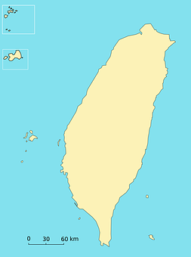

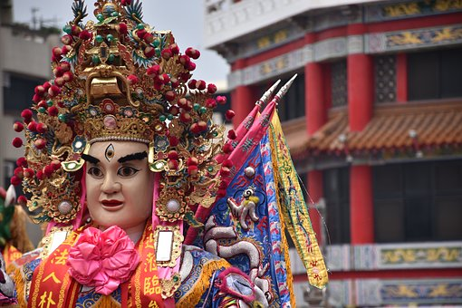


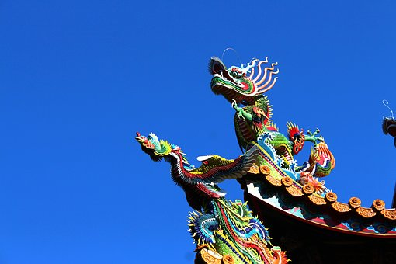
Lesson 1: I’m From Taiwan

Slide 3
運動專業英語
English for Athletes
Lesson 1: I’m From Taiwan
Part 4: Practice

Slide 4
運動專業英語
English for Athletes
Lesson 1: I’m From Taiwan
Part 4:
Read each of the sentences two times.

Slide 5
Dialogue 1 (1/4)
Allen: Hi, how are you? I’m Allen
Johnson.
Grace: Hi, I’m Grace Chen. Nice to
meet you.

Slide 6
Dialogue 1 (2/4)
Allen: Nice to meet you, too. I’m
from Canada. What about
you?
Grace: I’m from Taiwan. I major in
Physical Education at
National Taiwan Normal
University.

Slide 7
Dialogue 1 (3/4)
Allen: Really? You’re from Taiwan.
That’s so cool!
Grace: Have you heard of Taiwan
before?
Allen: Yes, I’ve heard that it’s a
beautiful country.

Slide 8
Dialogue 1 (4/4)
Grace: It really is. Taiwan is
famous for its beautiful
scenery.
Allen: I really hope I can go to
Taiwan sometime.
Grace: You really should. I’ll be
happy to show you
around.

Slide 9
Dialogue 2 (1/5)
Allen: Do you have a match this
evening?
Grace: Yes, at 7:00 p.m. I’m a
little nervous. My
opponent has a great
serve.

Slide 10
Dialogue 2 (2/5)
Allen: I’m sure you will do well. I
saw you practicing. You
have a great forehand and
backhand.
Grace: Thank you.

Slide 11
Dialogue 2 (3/5)
Allen: I need to go meet my
coach. I hope to see you
again. I saw on the
schedule you are playing
singles, doubles, and
mixed doubles.

Slide 12
Dialogue 2 (4/5)
Grace: Yes, what about you?
Allen: I’m playing singles and
doubles, too. So I’m sure
we will meet each other
again. I need to go to the
locker room now.

Slide 13
Dialogue 2 (5/5)
Grace: Okay. Hope we can chat
again.
Allen: Good luck tonight, Grace.
Grace: Thanks, Allen. See you later.
Allen: Bye.

Slide 14
Language Note:
English Conversations
Directions: Repeat after the speaker. Say each one 3 times.
Could you please say that again?
Could you please speak a little slower?
I’m sorry. I can’t understand what you are saying.

Slide 15
運動專業英語
English for Athletes
Lesson 1: I’m From Taiwan
Part 4: Practice

Slide 16
Conversation Practice
Directions: Listen to the speaker. Then read the English sentence two times.
Hi. My name is Bob (名字). I’m from Taiwan (國名).
Hello. I’m Kevin (名字). I’m a student in the Physical Education Department (體育系) at National Taichung University of Education (校名).

Slide 17
Conversation Practice
3. Hi, I’m Tony (名字) from Italy (國名).
I’m a baseball player (棒球選手).
4. Hi, my name is Maggie (名字). It’s
nice to meet you. I’m on the tug-of-
war team (拔河隊).

Slide 18
Conversation Practice
5. Hi there. I’m Karl (名字). I’m a
swimmer (游泳者) and I am from
Germany (國名).

Slide 19
運動專業英語
English for Athletes
Lesson 1: I’m From Taiwan
Part 4:
Fill in the blanks. Read each of the sentences two times.

Slide 20
Conversation Practice
Directions: Fill in the blanks and then read the sentences two times.
Hi. My name is ___ (名字). I’m from ___ (國名).
Hello. I’m ___ (名字). I’m a student in the _____ (體育系) at ___ (校名).

Slide 21
Conversation Practice
Directions: Fill in the blanks and then read the sentences.
3. Hi, I’m ___ (名字) from ___ (國名).
I’m a ___(棒球選手).
4. Hi, my name is ___ (名字). It’s
nice to meet you. I’m on the ___
(拔河隊).

Slide 22
Conversation Practice
Directions: Fill in the blanks and then read the sentences.
5. Hi there. I’m ___ (名字). I’m a
___ (游泳者) and I am from
___ (國名).

Slide 23
運動專業英語
English for Athletes
Lesson 1: I’m From Taiwan
This is the end of Lesson 1,
Part 4.

