Slide 1


運動專業英語
English for Athletes

Slide 2
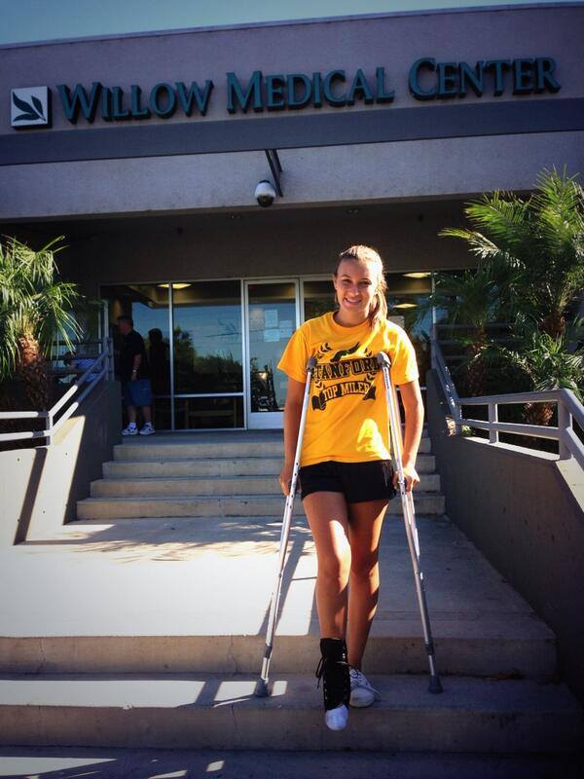
Lesson 2: What Happened to Your Leg?

Slide 3
運動專業英語
English for Athletes
Lesson 2:
What Happened to Your Leg?
Part 1: Dialogue 1

Slide 4
Dialogue 1 (1/6)
The situation: Hailey Chen and Tim Guo are teammates on a badminton team. Hailey has just returned from a badminton tournament in Indonesia. They meet in the cafeteria of the training center.

Slide 5
Dialogue 1 (2/6)
Tim: What happened to your leg?
Hailey: I sprained my ankle.

Slide 6
Dialogue 1 (3/6)
Tim: Oh, that’s too bad. How did it happen?
Hailey: I slipped and twisted my ankle during the final match.

Slide 7
Dialogue 1 (4/6)
Tim: Oh, no! Is it a serious injury?
Hailey: My coach put ice on my ankle. Then she took me to the hospital for an x-ray. The doctor said it is just a bad sprain.

Slide 8
Dialogue 1 (5/6)
Tim: You should rest. And keep your leg elevated.
Hailey: Thanks for your advice.

Slide 9
Dialogue 1 (6/6)
Tim: Do you need help with anything?
Hailey: I have to use crutches. Could you help me carry my tray to the table?
Tim: Sure. No problem.

Slide 10
Dialogue 1 – Vocabulary & Phrases
teammate (隊友)
badminton (羽毛球)
tournament (比賽)
Indonesia (印尼)
cafeteria (自助餐廳)

Slide 11
Dialogue 1 – Vocabulary & Phrases
Repeat after the Speaker
teammate (隊友)
badminton (羽毛球)
tournament (比賽)
Indonesia (印尼)
cafeteria (自助餐廳)

Slide 12
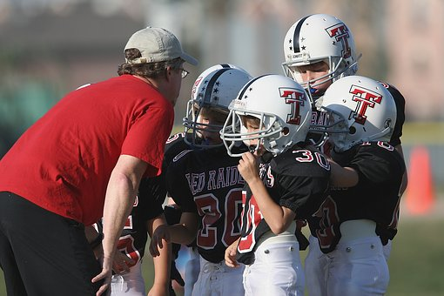
Vocabulary & Phrases—Practice
Repeat after the Speaker
teammate (隊友)
The boys are teammates on the football team.

Slide 13
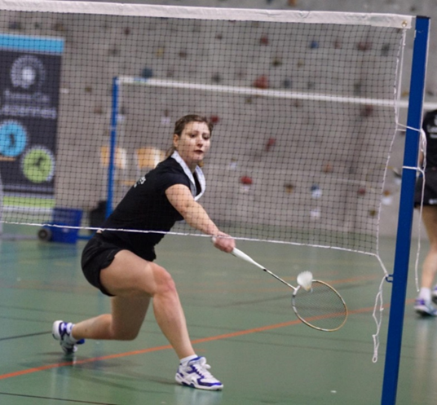
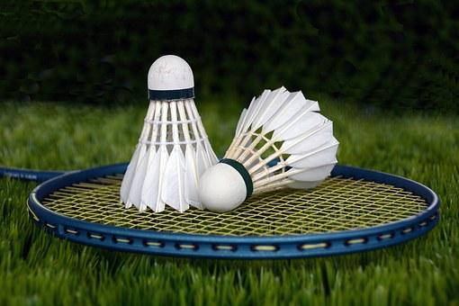
Vocabulary & Phrases—Practice
Repeat after the Speaker
badminton (羽毛球)
Badminton is a popular sport in Taiwan.

Slide 14
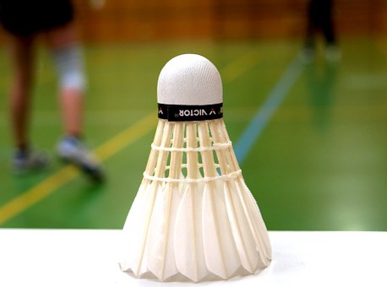
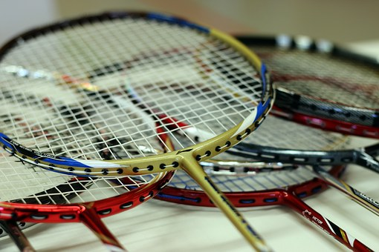
Vocabulary & Phrases—Practice
Repeat after the Speaker
tournament (比賽)
The team will participate in a badminton tournament this weekend.

Slide 15



Vocabulary & Phrases—Practice
Repeat after the Speaker
Indonesia (印尼)
Many people from Taiwan like to go to Indonesia for vacation.

Slide 16
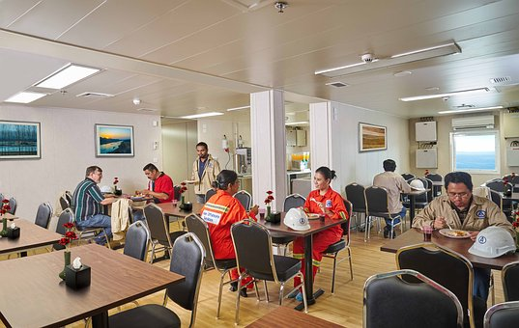
Vocabulary & Phrases—Practice
Repeat after the Speaker
cafeteria (自助餐廳)
She eats lunch every day in the company cafeteria.

Slide 17
Dialogue 1 – Vocabulary & Phrases
training center (訓練中心)
to sprain (使扭傷)
ankle (腳踝)
to slip (使滑倒)
to twist (使扭轉)

Slide 18
Dialogue 1 – Vocabulary & Phrases
Repeat after the Speaker
training center (訓練中心)
to sprain (使扭傷)
ankle (腳踝)
to slip (使滑倒)
to twist (使扭轉)

Slide 19
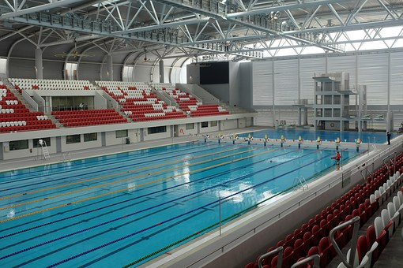

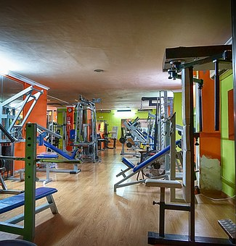
Vocabulary & Phrases—Practice
Repeat after the Speaker
training center (訓練中心)
The facilities at the training center are very good.

Slide 20
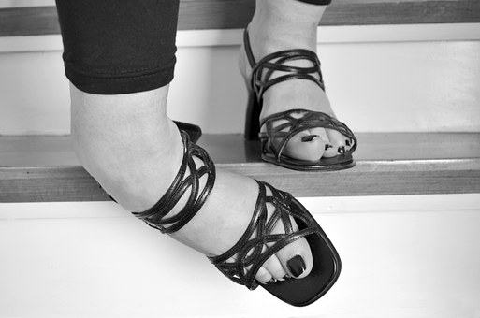
Vocabulary & Phrases—Practice
Repeat after the Speaker
to sprain (使扭傷)
She fell on the stairs and sprained her ankle.

Slide 21
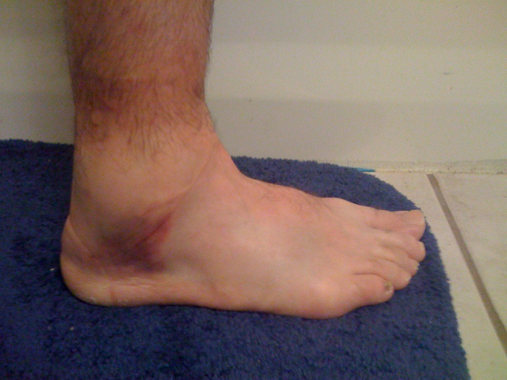
Vocabulary & Phrases—Practice
Repeat after the Speaker
ankle (腳踝)
She slipped during the match and sprained her ankle.

Slide 22
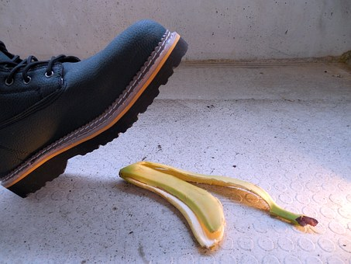
Vocabulary & Phrases—Practice
Repeat after the Speaker
to slip (使滑倒)
Don’t slip on the banana peel.

Slide 23
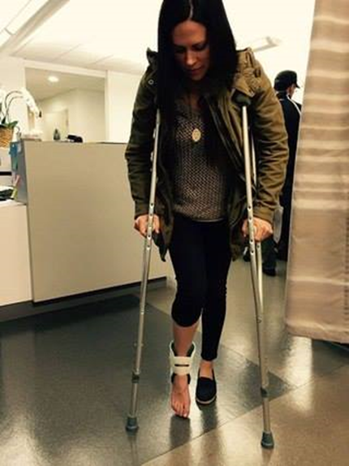
Vocabulary & Phrases—Practice
Repeat after the Speaker
to twist (使扭轉)
Donna slipped on the court and twisted her ankle.

Slide 24
Dialogue 1 – Vocabulary & Phrases
injury (傷害)
coach (教練)
ice (冰)
hospital (醫院)
x-ray (x-光)

Slide 25
Dialogue 1 – Vocabulary & Phrases
Repeat after the Speaker
injury (傷害)
coach (教練)
ice (冰)
hospital (醫院)
x-ray (x-光)

Slide 26
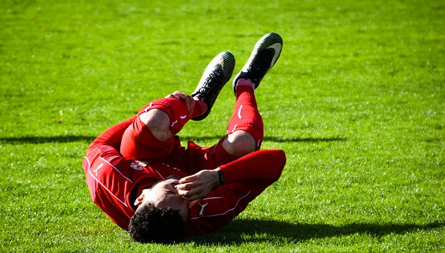
Vocabulary & Phrases—Practice
Repeat after the Speaker
injury (受傷)
The injury to his leg looks very serious.

Slide 27
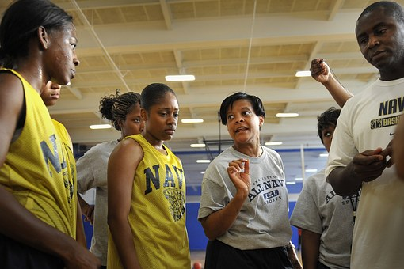
Vocabulary & Phrases—Practice
Repeat after the Speaker
coach (教練)
The new coach has helped Ivy to improve her skills.

Slide 28
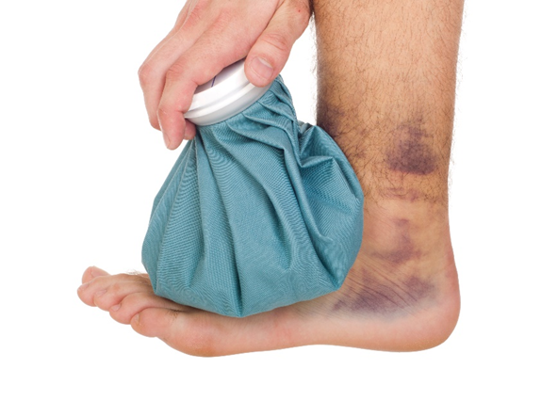
Vocabulary & Phrases—Practice
Repeat after the Speaker
ice (冰)
Your ankle is starting to get red and swollen. You should put some ice on it.

Slide 29

Vocabulary & Phrases—Practice
Repeat after the Speaker
hospital (醫院)
The injury is serious. Bob will need to stay overnight at the hospital.

Slide 30
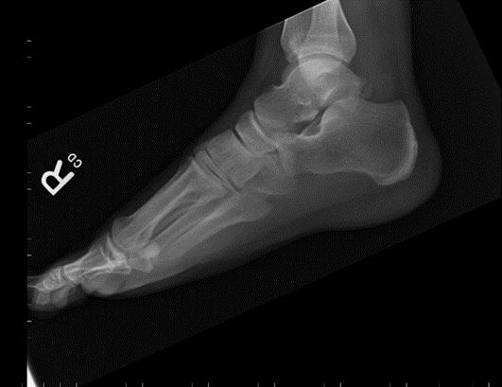
Vocabulary & Phrases—Practice
Repeat after the Speaker
x-ray (x-光)
The doctor showed Sara the x-ray of her ankle.

Slide 31
Dialogue 1 – Vocabulary & Phrases
rest (休息)
to elevate (提高)
advice (勸告)
crutches (拐杖)
tray (托盤/置物盤)

Slide 32
Dialogue 1 – Vocabulary & Phrases
Repeat after the Speaker
rest (休息)
to elevate (提高)
advice (勸告)
crutches (拐杖)
tray (托盤/置物盤)

Slide 33
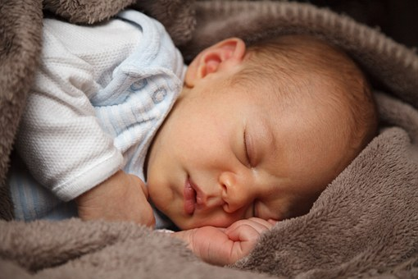
Vocabulary & Phrases—Practice
Repeat after the Speaker
rest (休息)
You need rest to recover from your injury.

Slide 34
Vocabulary & Phrases—Practice
Repeat after the Speaker
to elevate (提高)
Keep your ankle elevated so that it doesn’t get swollen.

Slide 35

Vocabulary & Phrases—Practice
Repeat after the Speaker
advice (勸告)
Thank you for your advice. It is very helpful.

Slide 36
Vocabulary & Phrases—Practice
Repeat after the Speaker
crutches (拐杖)
Her ankle is very sore so Jenny needs to use crutches.

Slide 37
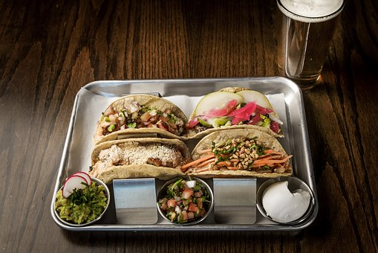
Vocabulary & Phrases—Practice
Repeat after the Speaker
tray (托盤/置物盤)
Conor’s tray was filled with lots of good food.

Slide 38
運動專業英語
English for Athletes
Lesson 2:
What Happened to Your Leg?
This is the end of Lesson 2, Part 1.

