Slide 1


運動專業英語
English for Athletes

Slide 2
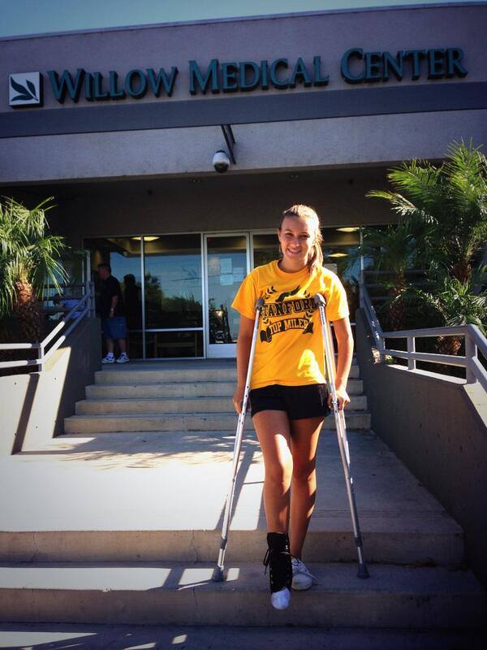
Lesson 2: What Happened to Your Leg?

Slide 3
Lesson 2:
What Happened to Your Leg?
Part 2: Dialogue 2

Slide 4
Dialogue 2 (1/8)
The situation:
Alice Chang and Tony Wu are classmates. They meet each other after class one afternoon.

Slide 5
Dialogue 2 (2/8)
Alice: Hi, Tony! How is your arm?
Tony: It’s still a little sore. But it’s much better this week.

Slide 6
Dialogue 2 (3/8)
Alice: I’m glad your arm feels better. What did the doctor say?
Tony: It probably happened because I was training too hard. The doctor said to remember that rest is also very important.

Slide 7
Dialogue 2 (4/8)
Alice: That’s true.
Tony: The doctor said next week I can start to do some light exercises to strengthen my elbow.

Slide 8
Dialogue 2 (5/8)
Alice: That’s good news. The baseball team needs you. You are the best pitcher in the league. And you are a great hitter, too.
Tony: Thank you for your compliment.

Slide 9
Dialogue 2 (6/8)
Tony: How did the softball team do today? Are you still undefeated?
Alice: We won. It was a close game. The score was 3-2.

Slide 10
Dialogue 2 (7/8)
Tony: Congratulations on your victory!
Alice: Thank you. Will you come to Joanne’s house on Saturday morning to watch the baseball game?

Slide 11
Dialogue 2 (8/8)
Tony: Definitely! The Yankees and the Red Sox are the best rivalry in the MLB. I’m sure the Red Sox will win!
Alice: No way! The Yankees are too strong this year.

Slide 12
Dialogue 2 – Vocabulary & Phrases
arm (手臂)
sore (酸痛)
much better (好多了)
doctor (醫生)
training too hard (訓練過於激烈)
rest (休息)

Slide 13
Dialogue 2 – Vocabulary & Phrases
Repeat after the Speaker
arm (手臂)
sore (酸痛)
much better (好多了)
doctor (醫生)
training too hard (訓練過於激烈)
rest (休息)

Slide 14
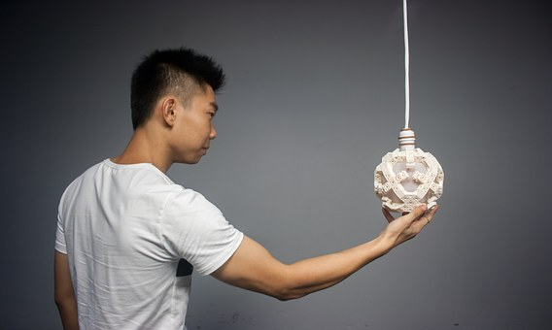
Vocabulary & Phrases—Practice
Repeat after the Speaker
arm (手臂)
He won’t be able to play in the baseball game. He injured his arm.

Slide 15
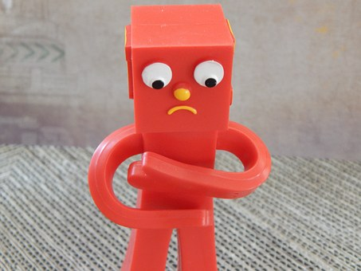
Vocabulary & Phrases—Practice
Repeat after the Speaker
sore (酸痛)
My arm muscles are very sore because I haven’t played badminton in a long time.

Slide 16
Vocabulary & Phrases—Practice
Repeat after the Speaker
much better (好多了)
After the physical therapy treatment, my ankle felt much better.

Slide 17

Vocabulary & Phrases—Practice
Repeat after the Speaker
doctor (醫生)
The doctor said I needed to get an x-ray of my elbow.

Slide 18


Vocabulary & Phrases—Practice
Repeat after the Speaker
training too hard (訓練過於激烈)
If you train too hard you are more likely to experience an injury.

Slide 19
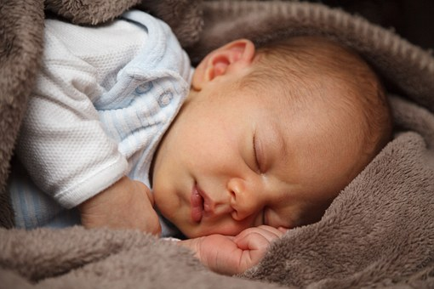
Vocabulary & Phrases—Practice
Repeat after the Speaker
rest (休息)
Rest is an important part of any training program.

Slide 20
Dialogue 2 – Vocabulary & Phrases
to strengthen (強化)
elbow (手肘)
baseball team (棒球隊)
pitcher (投手)
league (聯盟)
hitter (打擊者)
compliment (稱贊)

Slide 21
Dialogue 2 – Vocabulary & Phrases
Repeat after the Speaker
to strengthen (強化)
elbow (手肘)
baseball team (棒球隊)
pitcher (投手)
league (聯盟)
hitter (打擊者)
compliment (稱贊)

Slide 22
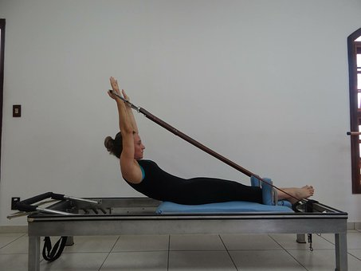
Vocabulary & Phrases—Practice
Repeat after the Speaker
to strengthen (強化)
The exercises will help the athlete to strengthen her arm.

Slide 23
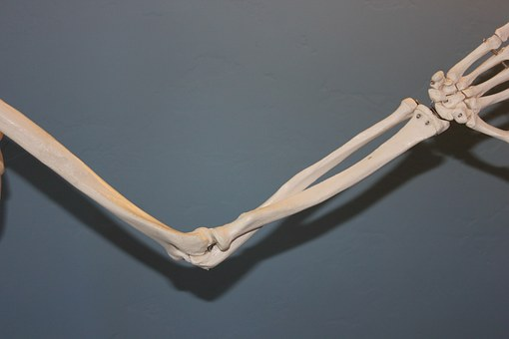
Vocabulary & Phrases—Practice
Repeat after the Speaker
elbow (手肘)
Edward’s elbow on his pitching arm feels very sore.

Slide 24
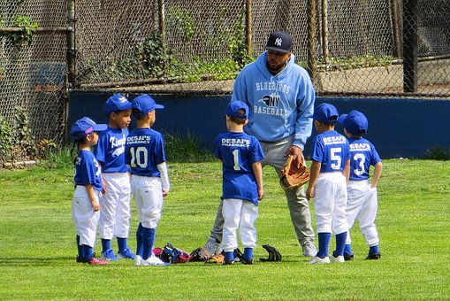
Vocabulary & Phrases—Practice
Repeat after the Speaker
baseball team (棒球隊)
They joined the baseball team in their town when they were children.

Slide 25
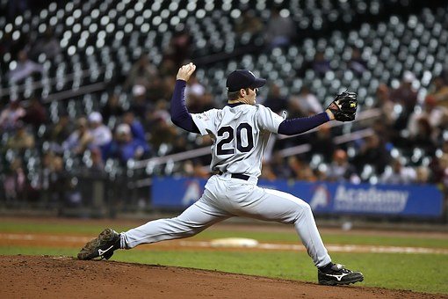
Vocabulary & Phrases—Practice
Repeat after the Speaker
pitcher (投手)
That MLB pitcher is amazing. He already has 20 wins.

Slide 26
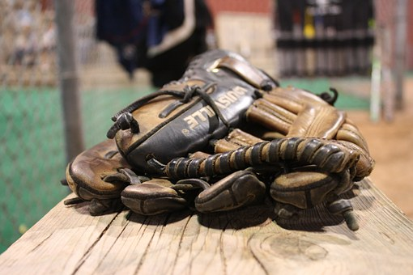
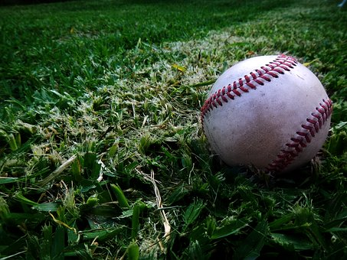
Vocabulary & Phrases—Practice
Repeat after the Speaker
league (聯盟)
The baseball league has 30 teams.

Slide 27
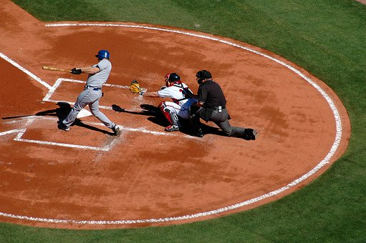
Vocabulary & Phrases—Practice
Repeat after the Speaker
hitter (打擊者)
He was the best hitter on the team last year. He hit 30 home runs.

Slide 28

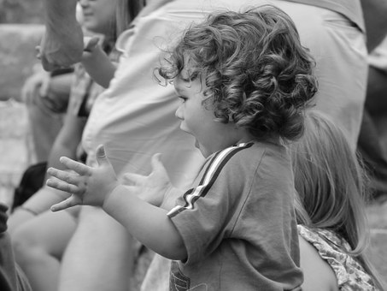
Vocabulary & Phrases—Practice
Repeat after the Speaker
compliment (稱贊)
Thank you for saying my dress looks nice. I appreciate your compliment.

Slide 29
Dialogue 2 – Vocabulary & Phrases
softball team (壘球隊)
undefeated (不敗)
close game (比賽非常接近)
score (得分)
Congratulations! (恭喜)

Slide 30
Dialogue 2 – Vocabulary & Phrases
Repeat after the Speaker
softball team (壘球隊)
undefeated (不敗)
close game (比賽非常接近)
score (得分)
Congratulations! (恭喜)

Slide 31
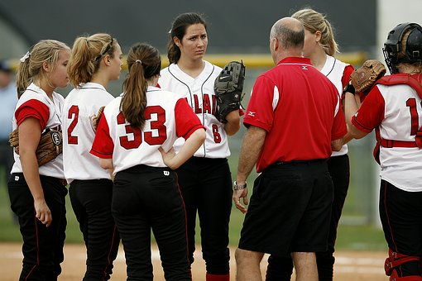
Vocabulary & Phrases—Practice
Repeat after the Speaker
softball team (壘球隊)
The softball team at that university is one of the best teams in the country.

Slide 32

Vocabulary & Phrases—Practice
Repeat after the Speaker
undefeated (不敗)
They were the only team in the league to go undefeated last season.

Slide 33
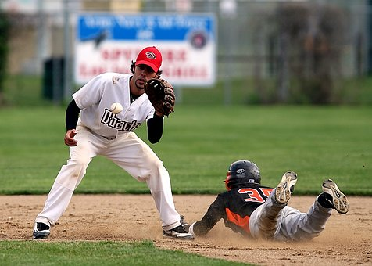
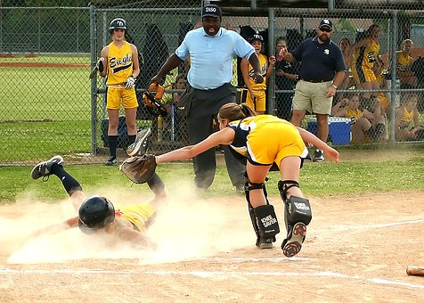
Vocabulary & Phrases—Practice
Repeat after the Speaker
close game (比賽非常接近)
What a close game! The Tigers won by one run.

Slide 34
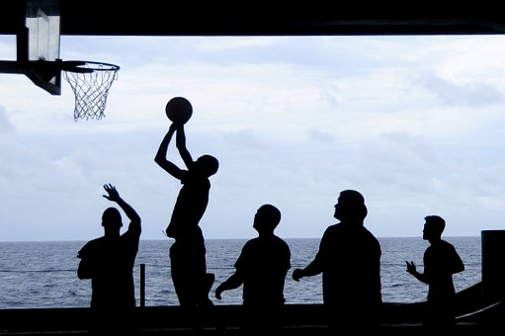
Vocabulary & Phrases—Practice
Repeat after the Speaker
score (得分)
What is the score of the game?

Slide 35
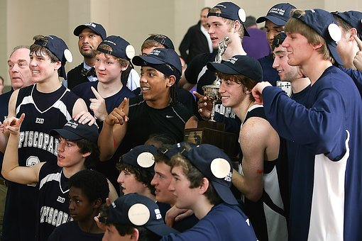
Vocabulary & Phrases—Practice
Repeat after the Speaker
Congratulations! (恭喜)
Congratulations on your victory!

Slide 36
Dialogue 2 – Vocabulary & Phrases
Definitely! (一定!)
Yankees (洋基隊)
Red Sox (紅襪隊)
rivalry (對抗)
MLB (美國職業棒球大聯盟)
No way! (不可能!)

Slide 37
Dialogue 2 – Vocabulary & Phrases
Repeat after the Speaker
Definitely! (一定!)
Yankees (洋基隊)
Red Sox (紅襪隊)
rivalry (對抗)
MLB (美國職業棒球大聯盟)
No way! (不可能!)

Slide 38
Vocabulary & Phrases—Practice
Repeat after the Speaker
Definitely! (一定!)
I will definitely ask the teacher for extra help. I want to pass this class.

Slide 39
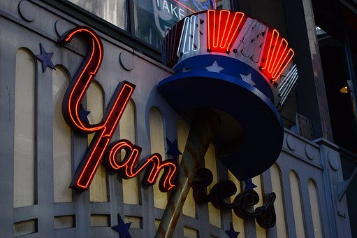
Vocabulary & Phrases—Practice
Repeat after the Speaker
Yankees (洋基隊)
Chien-ming Wang used to play for the Yankees.

Slide 40
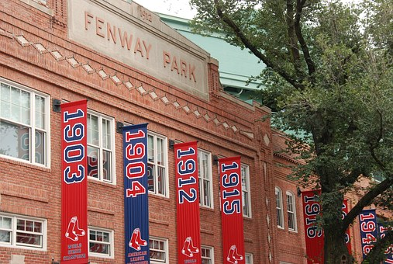
Vocabulary & Phrases—Practice
Repeat after the Speaker
Red Sox (紅襪隊)
The Red Sox play at Fenway Park, one of the oldest ballparks in the U.S.

Slide 41
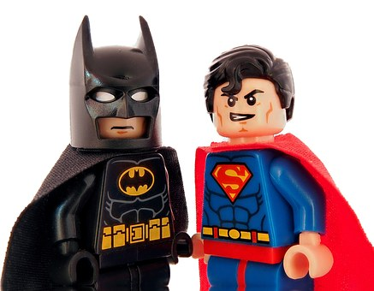
Vocabulary & Phrases—Practice
Repeat after the Speaker
rivalry (對抗)
Is there a rivalry between Batman and Superman?

Slide 42
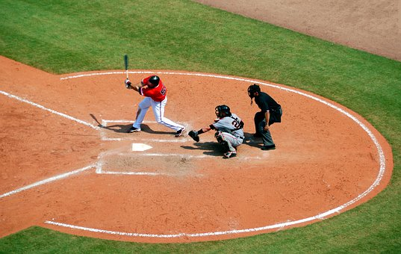
Vocabulary & Phrases—Practice
Repeat after the Speaker
MLB (美國職業棒球大聯盟)
MLB stands for Major League Baseball.

Slide 43
Vocabulary & Phrases—Practice
Repeat after the Speaker
No way! (不可能!)
No way Jack will pass the test. He never comes to class.

Slide 44
運動專業英語
English for Athletes
Lesson 2:
What Happened to Your Leg?
This is the end of Lesson 2, Part 2.

