Slide 1


運動專業英語
English for Athletes

Slide 2
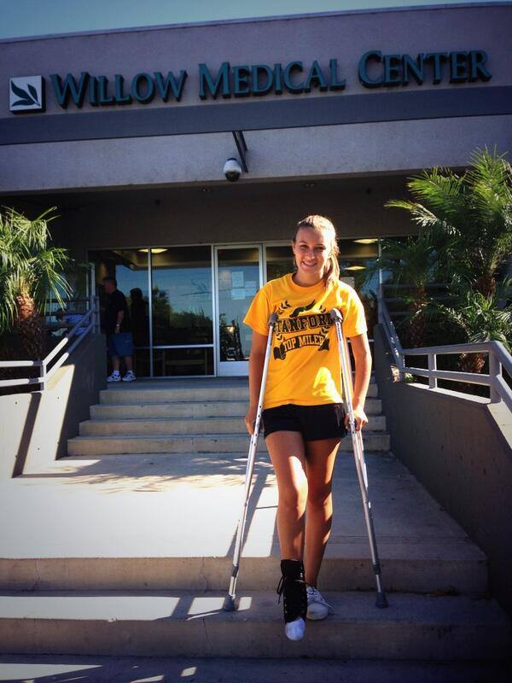
Lesson 2: What Happened to Your Leg?

Slide 3
Lesson 2:
What Happened to Your Leg?
Part 3: Practice

Slide 4
Vocabulary Practice
Directions: Fill in the blanks with the correct word.
Ivy slipped on the wet floor and sprained her _____ (腳踝).

Slide 5
Vocabulary Practice
Directions: Repeat the sentence after the speaker.
Ivy slipped on the wet floor and sprained her ankle (腳踝).

Slide 6
Vocabulary Practice
Directions: Fill in the blanks with the correct word.
The coach put _____ (冰) on the injury.

Slide 7
Vocabulary Practice
Directions: Repeat the sentence after the speaker.
The coach put ice (冰) on the injury.

Slide 8
Vocabulary Practice
Directions: Fill in the blanks with the correct word.
The coach took Ivy to the _____
(醫院).

Slide 9
Vocabulary Practice
Directions: Repeat the sentence after the speaker.
The coach took Ivy to the hospital
(醫院).

Slide 10
Vocabulary Practice
Directions: Fill in the blanks with the correct word.
The doctor said Ivy needed to get an _____ (x-光).

Slide 11
Vocabulary Practice
Directions: Repeat the sentence after the speaker.
The doctor said Ivy needed to get an x-ray (x-光).

Slide 12
Vocabulary Practice
Directions: Fill in the blanks with the correct word.
Ivy is lucky. She didn’t break her ankle. It is just a bad _____ (使扭傷).

Slide 13
Vocabulary Practice
Directions:. Repeat the sentence after the speaker.
Ivy is lucky. She didn’t break her ankle. It is just a bad sprain (使扭傷).

Slide 14
Vocabulary Practice
Directions: Fill in the blanks with the correct word.
When Ivy goes to the _____ (自助餐廳), she needs someone to help her.

Slide 15
Vocabulary Practice
Directions: Repeat the sentence after the speaker.
When Ivy goes to the cafeteria (自助餐廳), she needs someone to help her.

Slide 16
Vocabulary Practice
Directions: Fill in the blanks with the correct word.
Ivy can’t carry her _____ (托盤) because she is using crutches.

Slide 17
Vocabulary Practice
Directions: Repeat the sentence after the speaker.
Ivy can’t carry her tray (托盤) because she is using crutches.

Slide 18
Vocabulary Practice
Directions: Fill in the blanks with the correct word.
Sophie plays on the _____ (壘球隊).

Slide 19
Vocabulary Practice
Directions: Repeat the sentence after the speaker.
Sophie plays on the softball team
(壘球隊).

Slide 20
Vocabulary Practice
Directions: Fill in the blanks with the correct word.
Sophie hurt her elbow during the softball _____ (比賽).

Slide 21
Vocabulary Practice
Directions: Repeat the sentence after the speaker.
Sophie hurt her elbow during the softball tournament (比賽).

Slide 22
Vocabulary Practice
Directions: Fill in the blanks with the correct word.
Sophie is a _____ (投手).

Slide 23
Vocabulary Practice
Directions: Repeat the sentence after the speaker.
Sophie is a pitcher (投手).

Slide 24
Vocabulary Practice
Directions: Fill in the blanks with the correct word.
She is also a good _____ (打擊者).

Slide 25
Vocabulary Practice
Directions: Repeat the sentence after the speaker.
She is also a good hitter (打擊者).

Slide 26
Vocabulary Practice
Directions: Fill in the blanks with the best word.
Sophie’s elbow was very _____ (酸痛) so her coach took Sophie to the doctor.

Slide 27
Vocabulary Practice
Directions: Repeat the sentence after the speaker.
Sophie’s elbow was very sore (酸痛) so her coach took Sophie to the doctor.

Slide 28
Vocabulary Practice
Directions: Fill in the blanks with the best word.
The doctor said Sophie has been ________________ (訓練過於激烈).

Slide 29
Vocabulary Practice
Directions: Repeat the sentence after the speaker.
The doctor said Sophie has been training too hard (訓練過於激烈).

Slide 30
Vocabulary Practice
Directions: Fill in the blanks with the best word.
The doctor said Sophie needs to _____ (休息).

Slide 31
Vocabulary Practice
Directions: Repeat the sentence after the speaker.
The doctor said Sophie needs to rest
(休息).

Slide 32
Vocabulary Practice
Directions: Now practice all the sentences on your own.

Slide 33
運動專業英語
English for Athletes
Lesson 2:
What Happened to Your Leg?
This is the end of Lesson 2, Part 3.

