Slide 1


運動專業英語
English for Athletes

Slide 2
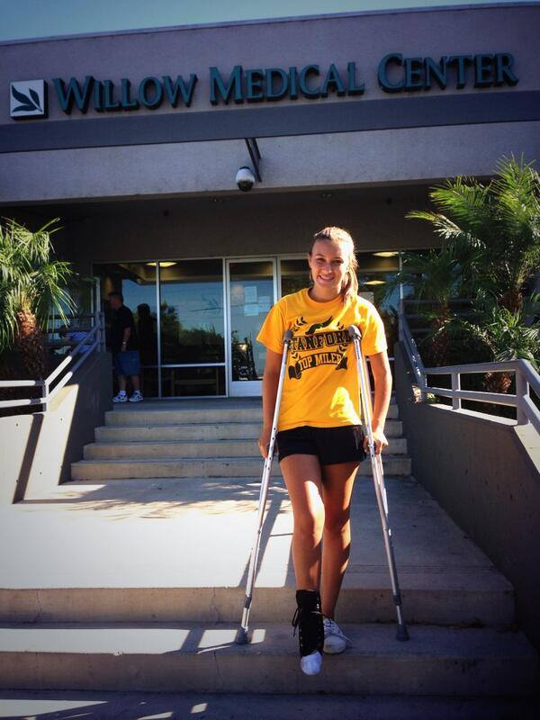
Lesson 2: What Happened to Your Leg?

Slide 3
Lesson 2:
What Happened to Your Leg?
Part 4: Useful Expressions

Slide 4
Useful Expressions
Directions: Repeat after the speaker.
What happened to your leg? (你的腿發生了什麼事?)
How did it happen? (它怎麼發生的?)
How did you get injured? (你是怎麼受傷的)
It hurt a lot. (它非常疼痛)

Slide 5
Useful Expressions
Directions: Repeat after the speaker.
What did the doctor say? (醫生說了什麼?)
I’m lucky. (我很幸運)
Thanks for your advice. (謝謝你的建議)

Slide 6
Useful Expressions
Directions: Repeat after the speaker.
Do you need help with anything? (你需要任何幫助嗎?)
Sure. No problem. (好沒問題)
Could you tell me a little more? (你能再多告訴我一次嗎？)

Slide 7
Useful Expressions
Directions: Repeat after the speaker.
Thanks for the explanation. (感謝您的解釋)
Of course. (當然)
Take care. (保重)
I hope you feel better soon.
(我希望你會很快好轉)

Slide 8
Useful Expressions
Directions: Repeat after the speaker.

Slide 9
Useful Expressions
Directions: Repeat after the speaker.

Slide 10
Useful Expressions
Directions: Repeat after the speaker.
Communicative Functions

Slide 11
Useful Expressions

Slide 12
Useful Expressions
Directions: Repeat after the speaker.

Slide 13
Useful Expressions
Directions: Now practice on your own.

Slide 14
Useful Expressions
Directions: Repeat after the speaker.

Slide 15
Useful Expressions
Directions: Now practice on your own.

Slide 16
運動專業英語
English for Athletes
Lesson 2:
What Happened to Your Leg?
This is the end of Lesson 2, Part 4.

