Slide 1


運動專業英語
English for Athletes

Slide 2
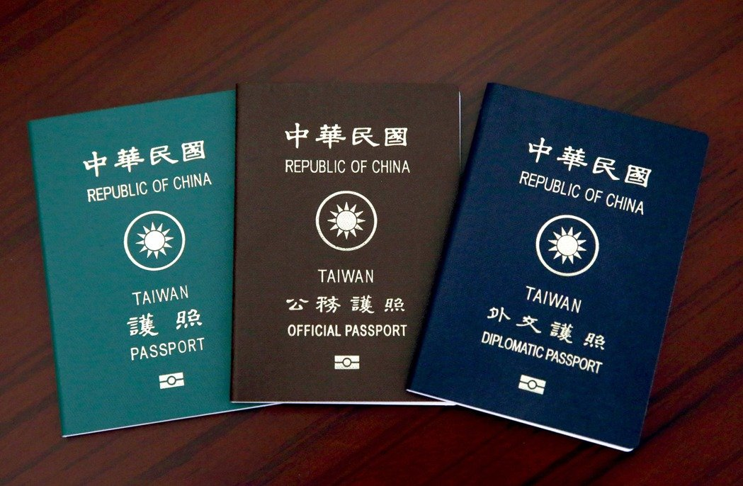
Lesson 3:
May I Have Your Passport, Please?
Part I: Dialogues

Slide 3
Dialogue 1 (the situation)
Eunice has just arrived in Jakarta, Indonesia. She is going through Immigration.

Slide 4
Dialogue 1 (1/3)
Officer A: May I have your
passport and related
forms, please?
Eunice: Sure. Here you go.
Officer A: How long will you be
staying in Indonesia?
Eunice: For two weeks.

Slide 5
Dialogue 1 (2/3)
Officer A: What’s the purpose of
your visit?
Eunice: I will take part in the
Asian Games.
Officer A: Where will you be
staying?
Eunice: At the Athletes’ Village in
Jakarta.

Slide 6
Dialogue 1 (3/3)
Officer A: Okay. Enjoy your stay in
Indonesia.
Eunice: Thank you.

Slide 7
Dialogue 1 – Vocabulary & Phrases
Indonesia (印尼)
Immigration (移民局)
passport (護照)
related forms (相關表格)
Asian Games (亞洲運動會)
Athletes’ Village (運動員村/選手村)

Slide 8
Practice: Repeat after the Speaker
Indonesia
Immigration
passport
related forms
Asian Games
Athletes’ Village

Slide 9

Vocabulary & Phrases—
Repeat after the Speaker
Indonesia （印尼）
Indonesia is located in Asia. It is made up of many islands.

Slide 10

Vocabulary & Phrases—
Repeat after the Speaker
Immigration （移民局）
Foreigners should go through Immigration before entering the U.S.

Slide 11
Vocabulary & Phrases—
Repeat after the Speaker
passport（護照）
You need to show your passport when you enter or leave a country.

Slide 12

Vocabulary & Phrases—
Repeat after the Speaker
related forms（相關表格）
Here are some related forms for you to sign.
Asian Games（亞洲運動會）
Indonesia will host the 2018 Asian Games.

Slide 13
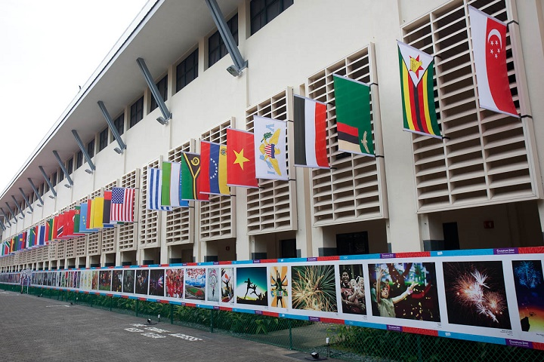
Vocabulary & Phrases—
Repeat after the Speaker
Athletes’ Village（運動員村/選手村）
Athletes live in the Athletes’ Village during the competition.

Slide 14
Dialogue 2 (the situation)
Eunice is standing in front of the Nothing to Declare Counter.

Slide 15
Dialogue 2a
Officer B: Please put your bag
here. Are you carrying
any food or gifts?
Eunice: No. These are just my
personal belongings.
Officer B: Okay. Welcome to
Indonesia.
Eunice: Thank you very much.

Slide 16
Dialogue 2 – Vocabulary & Phrases
Nothing to Declare (無須報關)
2. personal belongings (個人物品)

Slide 17
Practice: Repeat After the Speaker
Nothing to Declare
2. personal belongings

Slide 18
Vocabulary & Phrases—
Repeat after the Speaker
Nothing to Declare（無需報關）
Pass through the green gate if you have nothing to declare.

Slide 19

Vocabulary & Phrases—
Repeat after the Speaker
personal belongings（個人物品）
Be sure to take your personal belongings with you when you get off the train.

Slide 20
Dialogue 3 (the situation)
(Kevin, a taekwondo athlete, has just arrived at the airport in Thailand with his coach and teammates. After coming out of the restroom, he can’t find his coach, so he goes to the Tourist Service Center for help.)

Slide 21
Dialogue 3a
Kevin: Excuse me. I can’t find my
coach.
Staff: Don’t worry. Please tell me
what your name is and how I
can help you.
Kevin: I’m Kevin Lee, L-E-E. I’m
looking for my coach, Mr.
Chen.

Slide 22
Dialogue 3b
Staff: OK. Please tell me his full
name. Don’t worry.
Kevin: Wei-lung Chen. W-E-I-L-U-
N-G, C-H-E-N.
Staff: OK.

Slide 23
Dialogue 3c
(Announcement: Passenger Mr. Wei-lung Chen, please come to the Tourist Service Center. Your team member, Kevin Lee, is waiting for you here.)
Kevin: Thank you very much.

Slide 24
Dialogue 3 – Vocabulary & Phrases
taekwondo (跆拳道)
Thailand (泰國)
teammate (隊友)
restroom (廁所/洗手間)
coach (教練)
Tourist Service Center (旅客服務中心)
full name (全名)
8. announcement (廣播)

Slide 25
Practice: Repeat After the Speaker
taekwondo
Thailand
teammate
restroom
coach
Tourist Service Center
full name
8. announcement

Slide 26
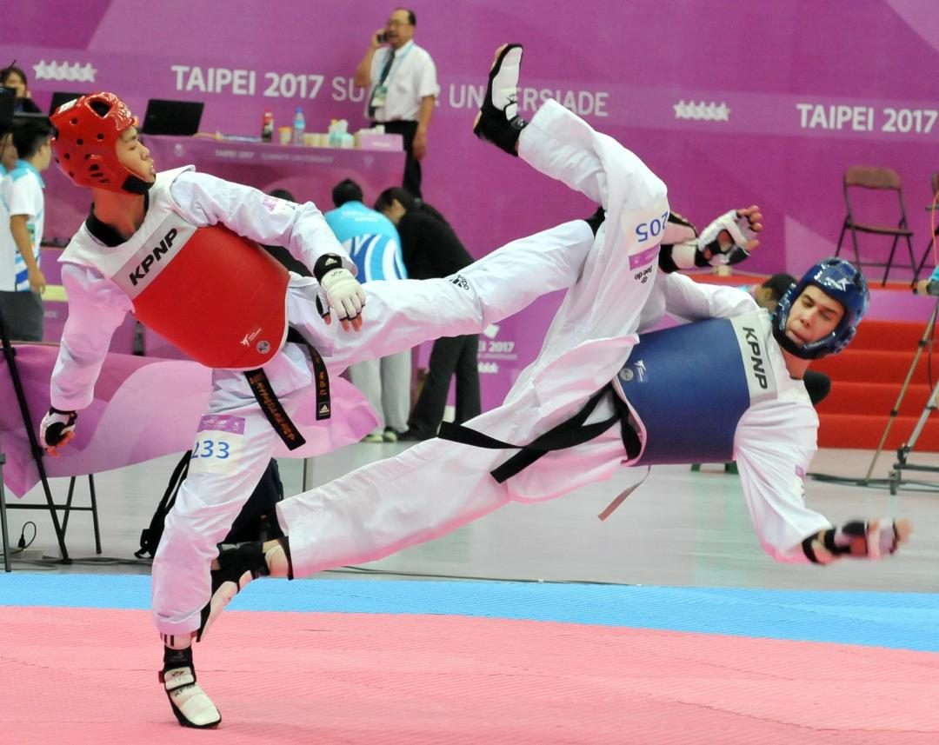
Vocabulary & Phrases—
Repeat after the Speaker
taekwondo（跆拳道）
Taekwondo is popular in Taiwan.

Slide 27

Vocabulary & Phrases—
Repeat after the Speaker
Thailand（泰國）
A large number of college students visit Thailand for their graduation trips.

Slide 28

Vocabulary & Phrases—
Repeat after the Speaker
teammate（隊友）
Teammates are important when you have a group project in class.

Slide 29

Vocabulary & Phrases—
Repeat after the Speaker
restroom（廁所、洗手間）
Go straight, and you will see the restroom on the left side.

Slide 30
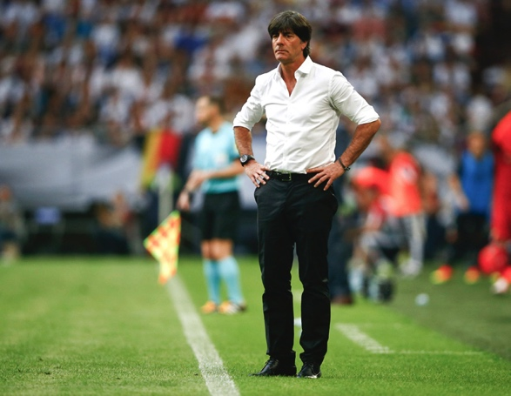
Vocabulary & Phrases—
Repeat after the Speaker
coach（教練）
He is the new coach of the football team.

Slide 31

Vocabulary & Phrases—
Repeat after the Speaker
Tourist Service Center（旅客服務中心）
Excuse me, could you please tell me where the Tourist Service Center is?

Slide 32
Vocabulary & Phrases—
Repeat after the Speaker
full name（全名）
My full name is Harry James Potter.
announcement（廣播）
The announcement is unexpected.

Slide 33
Culture Note
外國人的姓名排列和華人不同, 他們先講 名(first name/given name)再講 姓(last name/family name/surname).
名和姓中間也會有middle name, 平時不常用, 僅以字首代表, 但護照中一定要將全名拼出來.
例如:Henry Patrick Johnson, Henry為 first name, Patrick 為 middle name, Johnson 則為 last name. 平常會使用Henry P. Johnson.

Slide 34
This is the end of Lesson 3, Part 1.

