Slide 1


運動專業英語
English for Athletes

Slide 2
Lesson 3:
May I Have Your Passport, Please?
Part 2: Mini Dialogues

Slide 3
Mini Dialogue 1
(the situation)
(Alex is on the plane to Canada. It’s dinnertime, and the flight attendant is serving the meal.)

Slide 4
Mini Dialogue 1a
Flight attendant: It’s dinnertime,
Sir. Which entrée would you
like, beef or fish?
Alex: Beef, please.
Flight attendant: Would you like
anything to drink?
Alex: Could you please tell me
what you have?

Slide 5
Mini Dialogue 1b
Flight attendant: We have water,
juice, and coffee.
Alex: I’d like to have some juice,
please.
Flight attendant: OK. Here you are.
Enjoy your meal.

Slide 6
Mini Dialogue 2
(the situation)
(Paul is on the plane to Taiwan. He feels tired and cold. He’s talking to a flight attendant.)

Slide 7
Mini Dialogue 2a
Paul: Excuse me. I feel cold. Could
you give me a blanket and a
pillow?
Flight attendant: Of course.
Anything else?

Slide 8
Mini Dialogue 2b
Paul: I’d like to have some water,
please.
Flight attendant: I’ll get that for
you right away.
Paul: Thank you.

Slide 9
Word Power

Slide 10
Word Power

Slide 11
Useful Expressions
May I have your name, please? (請問你的姓名?)
Enjoy your stay here. (祝你在此過得愉快)
Welcome to Taiwan. (歡迎來到台灣)
Excuse me. I’m lost. (抱歉/對不起, 我迷路了)
I’m looking for my coach. (我正在找我的教練)

Slide 12
Communicative Functions Ia
Passenger: May I have a headset?
Flight attendant: Just a moment, please.
Passenger: Where can I put my bag?
Flight attendant: You can put it in the overhead compartment.

Slide 13
Communicative Functions Ib
Passenger: Would you show me how to fasten the seat belt?
Flight attendant: Sure, let me show you.

Slide 14
Communicative Functions IIa
Question: I can’t find my luggage.
Response: How many pieces of baggage have you lost?
Question: Is there an airport bus to the city?
Response: There’s one just outside the gate.

Slide 15
Communicative Functions IIb
Question: Can you tell me where to change money?
Response: There’s a currency exchange counter over there.
Question: Could you tell me how to fill out this form?
Response: Yes. Could you wait a moment, please?

Slide 16
Communicative Functions – Vocabulary & Phrases
headset (戴在頭上的耳機)
overhead compartment (座位上方的置物空間)
fasten (扣緊)
seat belt (安全帶)

Slide 17
Communicative Functions – Vocabulary & Phrases
luggage (行李, 英式)
baggage (行李, 美式)
gate (大門/登機門)
currency exchange counter (貨幣兌換櫃檯)

Slide 18
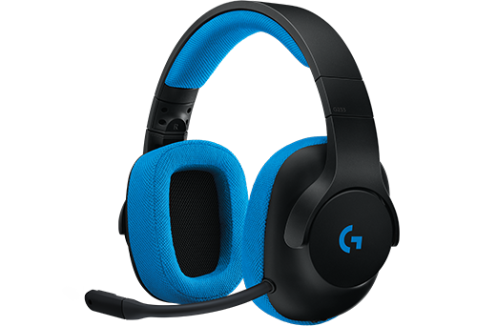
Vocabulary & Phrases—
Repeat after the Speaker
headset（戴在頭上的耳機）
You can use a headset to listen to music.

Slide 19
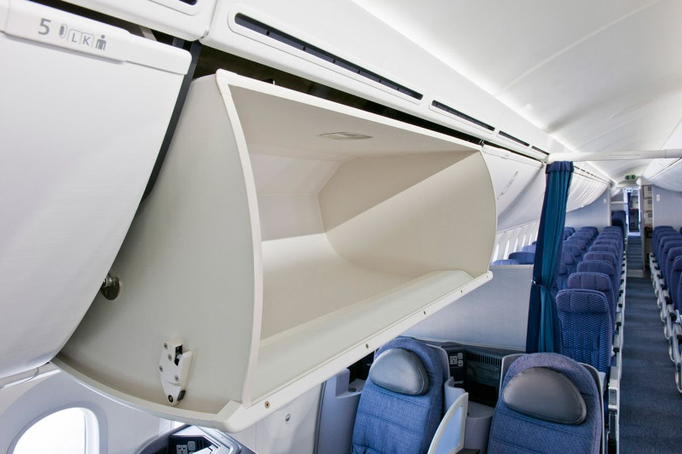
Vocabulary & Phrases—Practice
overhead compartment
（座位上方的置物空間）
The flight attendant helped me to put my luggage in the overhead compartment.

Slide 20
Vocabulary & Phrases—Practice
fasten（扣緊）
Make sure your seat belt is fastened.
seat belt （安全帶）
You must wear your seat belt.

Slide 21
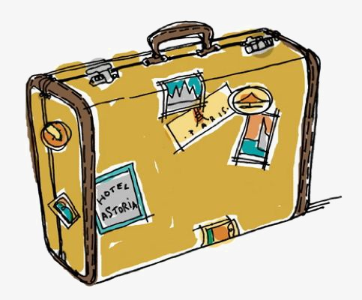
Vocabulary & Phrases—Practice
luggage（行李 英式）
I bought some new luggage for the trip.
baggage（行李 美式）
We dropped our baggage off at the hotel first, and then we went to the restaurant.

Slide 22
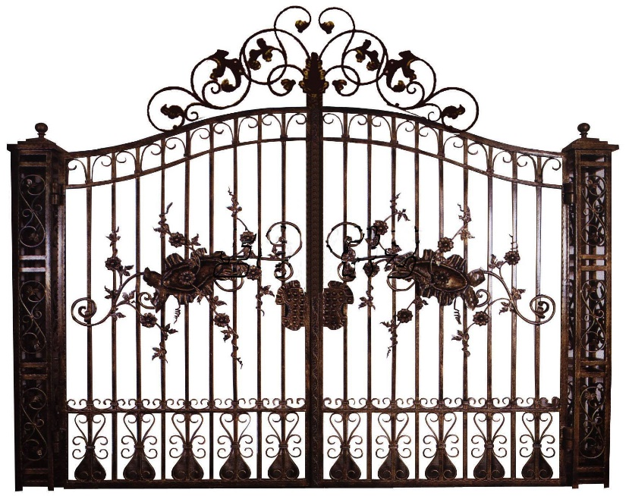
Vocabulary & Phrases—Practice
gate（大門/登機門）
Please shut the gate.
Passengers for Tokyo please proceed to Gate 10 for boarding.

Slide 23
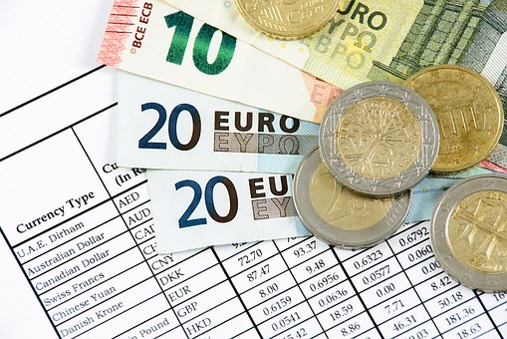
Vocabulary & Phrases—Practice
currency exchange counter（貨幣兌換櫃檯）
Kevin changed money at the currency exchange counter.

Slide 24
This is the end of Lesson 3, Part 2.

