Slide 1


運動專業英語
English for Athletes

Slide 2
Lesson 3:
May I Have Your Passport, Please?
Part 4: Filling in the necessary forms

Slide 3
You need your passport, boarding card and hotel/house information to fill in this form.
  Filling in the Necessary Forms

Slide 4
入境紀錄表(USA)

Slide 5
入境紀錄表-1
Family Name
First (Given) Name
Birth Date (DD/MM/YY)
Country of Citizenship
Sex (Male or Female)

Slide 6
入境紀錄表-2
Passport Issue Date (DD/MM/YY)
Passport Expiration Date (DD/MM/YY)
Passport Number
Airline and Flight Number

Slide 7
入境紀錄表-3
Country Where You Live
Country Where You Boarded
City Where Visa Was Issued
Date Issued (DD/MM/YY)

Slide 8
入境紀錄表-4
Address While in the United States (Number and Street)
City and State
Telephone Number in the U.S. Where You Can be Reached
Email Address

Slide 9
Filling in the Necessary Forms
Customs Declaration Form (Japan)

Slide 10
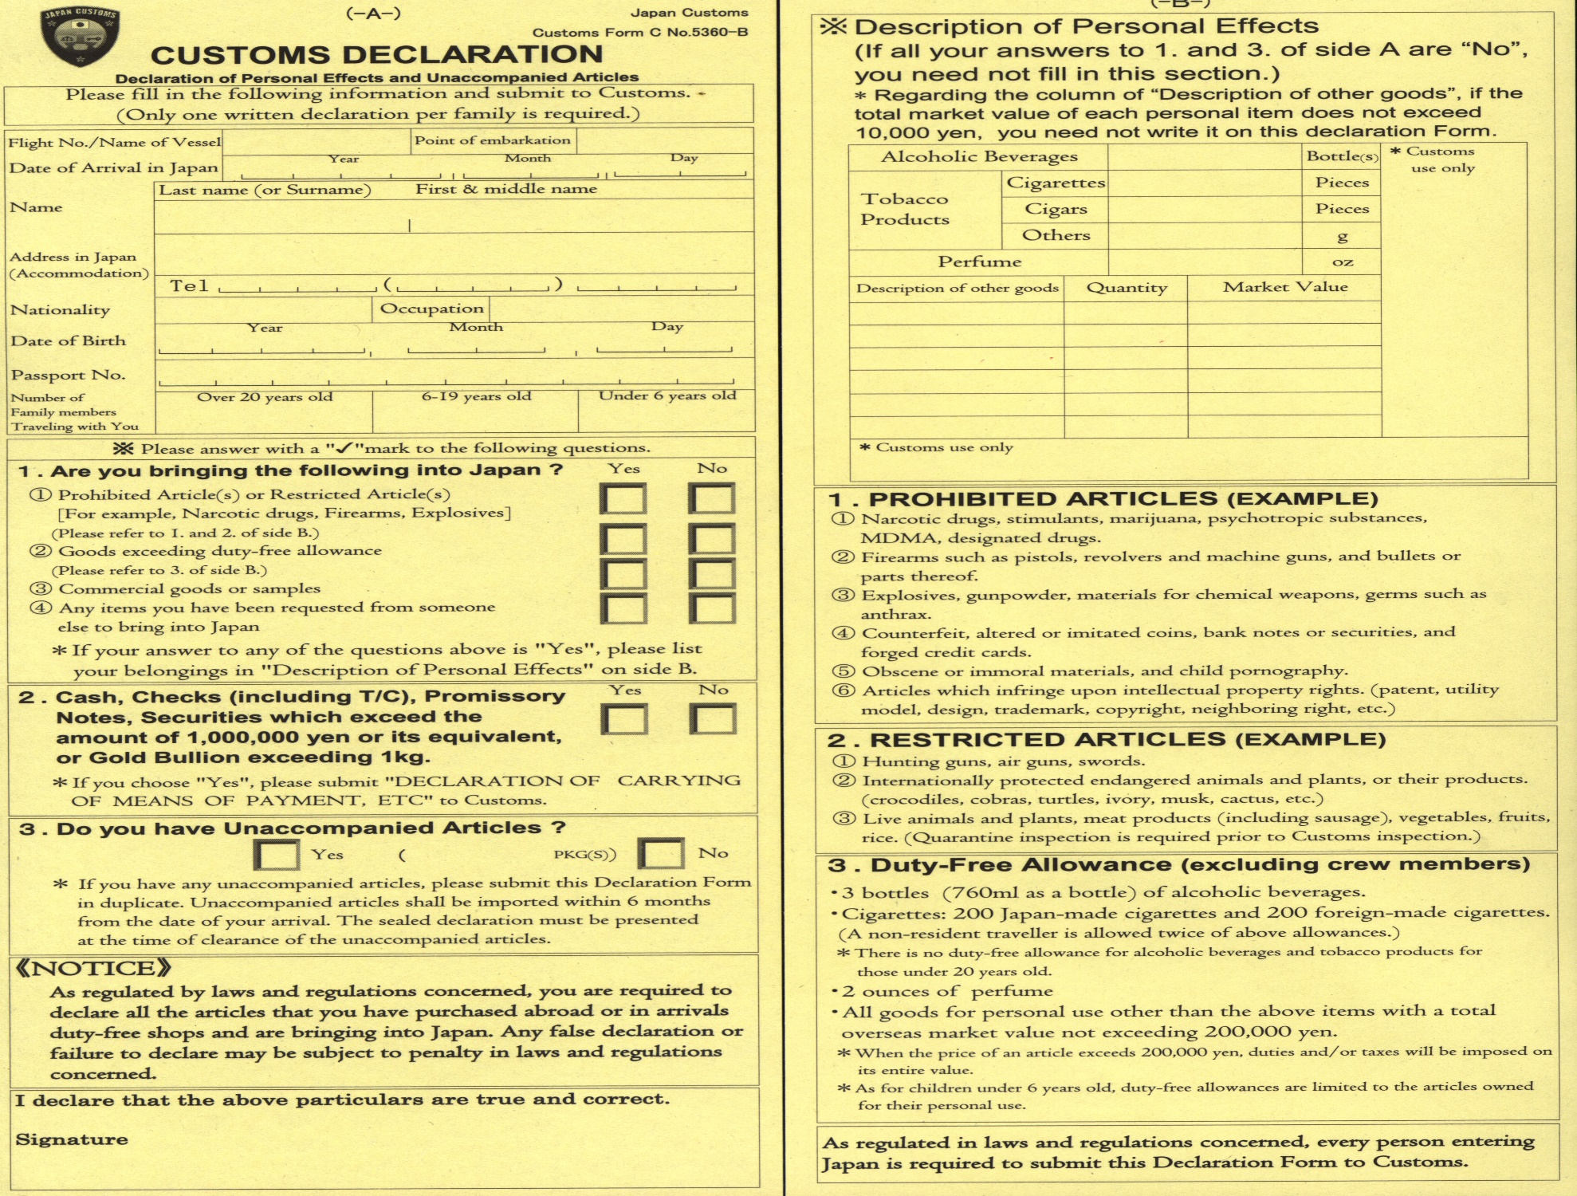

Slide 17
This is the end of Lesson 3, Part 4.

