Slide 1


運動專業英語
English for Athletes

Slide 3
Lesson 4:
I’d Like to Check In
Part 1: Dialogue 1

Slide 4
Dialogue 1 (the situation)
Bryan is making a reservation on the phone.

Slide 5
Dialogue 1a
Front Desk: Grand Hotel. May I
help you?
Bryan: I’d like to book rooms for
next Monday night.

Slide 6
Dialogue 1a
Front Desk: Would you like a
single room or a double room?
Bryan: I need three quad rooms,
please. What’s the rate for a
quad room?

Slide 7
Dialogue 1b
Front Desk: We have three rates,
two hundred, two hundred
twenty, and two hundred fifty
dollars per night, without tax.
Which one do you prefer?
Bryan: I’ll take the two hundred
dollar one, please.

Slide 8
Dialogue 1c
Front Desk: May I have your name,
please?
Bryan: It’s Bryan Chen.

Slide 9
Dialogue 1c
Front Desk: Could you spell that,
please?
Bryan: My first name is Bryan, B-
R-Y-A-N. And my last name is
Chen, C-H-E-N. I’ll be arriving at
4:15 p.m. next Monday.

Slide 10
Dialogue 1d
Front Desk: I’d like to confirm your
first name is Bryan. B for Bill, R
for Robert, Y for Young, A for
Alice and N for Nicole. And your
last name is Chen. C for Carl, H
for Henry, E for Edward, and N
for Nicole. Is that right?

Slide 11
Dialogue 1e
Bryan: Yes. That’s right.
Front Desk: Thank you. We’ll be
waiting to serve you. Goodbye.
Bryan: Goodbye.

Slide 12
Dialogue 1 – Vocabulary & Phrases
book（訂）
single（單人的）
quad room（四人房）
rate （費用）
per night（每晚）
tax（稅）
prefer（較喜歡）
spell（拼字）
serve（為…服務）

Slide 13
Dialogue 1 – Repeat after the Speaker
book（訂）
single（單人的）
quad room（四人房）
rate （費用）
per night（每晚）
tax（稅）
prefer（較喜歡）
spell（拼字）
serve（為…服務）

Slide 14
Vocabulary & Phrases—Practice
Repeat after the Speaker
book（訂）
Bill has booked a hotel room for our vacation.
single（單人的）
She is traveling alone. She will stay in a
single room.

Slide 15
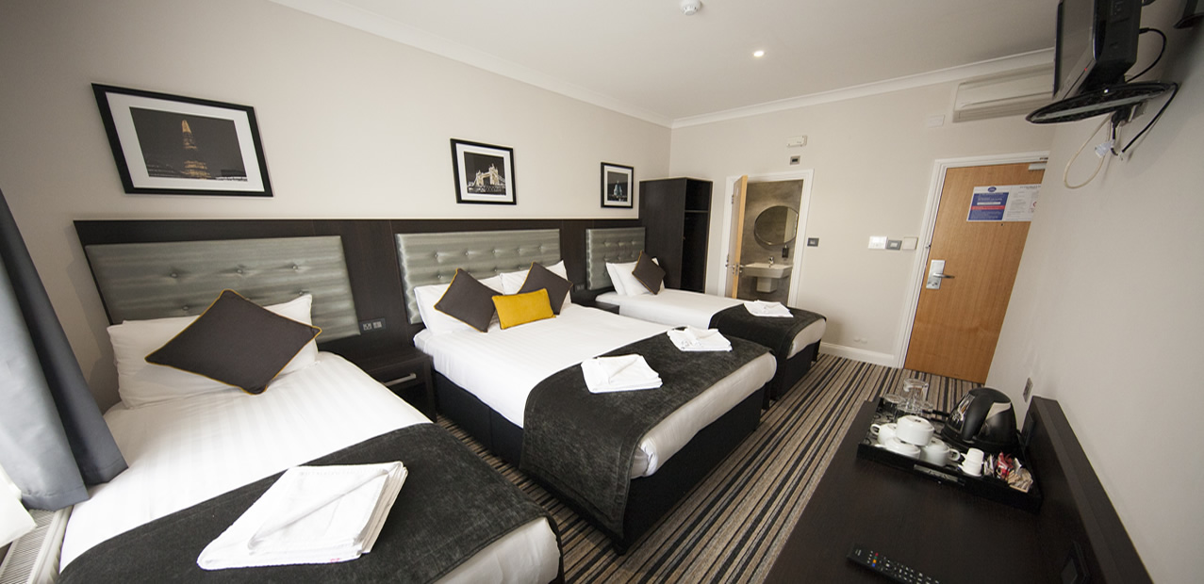
Vocabulary & Phrases—Practice
Repeat after the Speaker
quad room（四人房）
My mom booked a quad room for our family trip.

Slide 16
Vocabulary & Phrases—Practice
Repeat after the Speaker
rate（費用）
The restaurant has a special discount rate
for this month.
per night（每晚）
How much does this room cost per night?

Slide 17

Vocabulary & Phrases—Practice
Repeat after the Speaker
tax（稅）
Our government plans to increase the tax
on cigarettes.

Slide 18
Vocabulary & Phrases—Practice
Repeat after the Speaker
prefer（較喜歡）
I prefer tea to coffee.
spell（拼字）
He doesn’t know how to spell my name.

Slide 19

Vocabulary & Phrases—Practice
Repeat after the Speaker
serve（為…服務）
The wedding dinner will be served at 6:00 pm.

Slide 20
運動專業英語
English for Athletes
Lesson 4: I’d Like to Check In
This is the end of Lesson 4,
Part 1.

