Slide 1


運動專業英語
English for Athletes

Slide 3
Lesson 4:
I’d Like to Check In
Part 2: Dialogue 2

Slide 4
Dialogue 2 (the situation)
(Susan and her students have just arrived at the hotel. They are checking in.)

Slide 5
Dialogue 2a
Front Desk: Good afternoon,
ma’am. Welcome to the Holiday
Hotel. May I help you?
Susan: Yes. We’d like to check in.

Slide 6
Dialogue 2a
Front Desk: May I have your name,
please?
Susan: Yes. It’s Susan Huang.

Slide 7
Dialogue 2b
Front Desk: Could you please wait
a moment? Let me pull up your
reservation on the computer.
Your reservation is for three quad
rooms for three nights. Could
you please fill out the
registration card?

Slide 8
Dialogue 2b
Susan: Sure. (Filling out the form)
Is this all right?

Slide 9
Dialogue 2c
Front Desk: Yes, thank you. How
would you like to pay? By cash or
credit card?
Susan: By Visa card.

Slide 10
Dialogue 2c
Front Desk: May I have your card,
please.
Susan: Here you go.

Slide 11
Dialogue 2d
Front Desk: Thank you, ma’am.
Your rooms are 325, 326, and
327. Here are your key cards.
The porter will take you to your
rooms.

Slide 12
Dialogue 2d
Susan: Thank you very much.
Front Desk: You’re welcome. Enjoy
your stay with us.

Slide 13
Culture Note
你知道出國旅遊時應該如何給小費嗎？在美國，給小費是常見的習慣。一般來說，小費是消費額的10%~15%。在日本，當進入飯店時，可給接待的服務生一些小費，其他人員則可不必付。在泰國，小費無論如何都是必要的。在新加坡，官方強調不收小費，因為他們國家以清潔為基本文化，如果給小費會破壞他們的文化。在澳大利亞，沒有給小費的習慣。

Slide 14
Culture Note
瑞士的飯店餐館不公開收取小費，而司機則可依規定收取車費10%的小費。在法國，服務性的行業可收不低於價款10%的小費。在義大利，當遇到服務生有「拒收」的「示意」時，你最好是趁送帳單時遞上小費。在旅館裡，通常每週給打掃清潔的服務生5歐元，搭計程車則不一定要給小費，把車錢湊成整數就行了。

Slide 15
Dialogue 2 – Vocabulary & Phrases
check in（報到；投宿登記手續）
ma’am（夫人）
reservation（預定）
fill out（填寫）
registration card（住宿登記卡）
credit card（信用卡）
key card（門卡）
porter（行李員）

Slide 16
Dialogue 2 – Vocabulary & Phrases—Repeat after the Speaker
check in（報到；投宿登記手續）
ma’am（夫人）
reservation（預定）
fill out（填寫）
registration card（住宿登記卡）
credit card（信用卡）
key card（門卡）
porter（行李員）

Slide 17
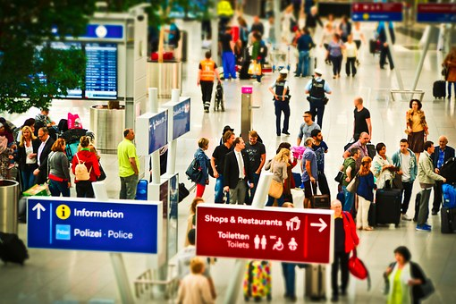
Vocabulary & Phrases
Repeat after the Speaker
check in（報到；投宿登記手續）
You can save time by checking in online.

Slide 18
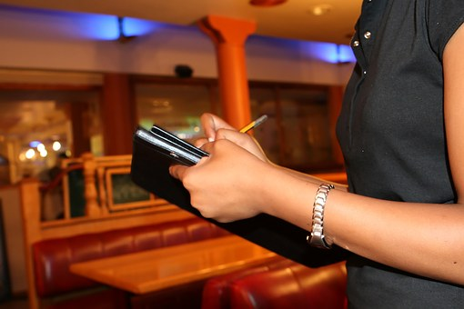
Vocabulary & Phrases
Repeat after the Speaker
ma’am（夫人）
How can I help you, ma’am?

Slide 19
Vocabulary & Phrases
Repeat after the Speaker
reservation（預定）
I’d like to make a reservation for
two people.
fill out（填寫）
Please fill out this form.

Slide 20
Vocabulary & Phrases
Repeat after the Speaker
registration card（住宿登記卡）
You need to fill in a registration card when you check in at a hotel.
credit card（信用卡）
I can only pay cash because I don’t have a
credit card.

Slide 21
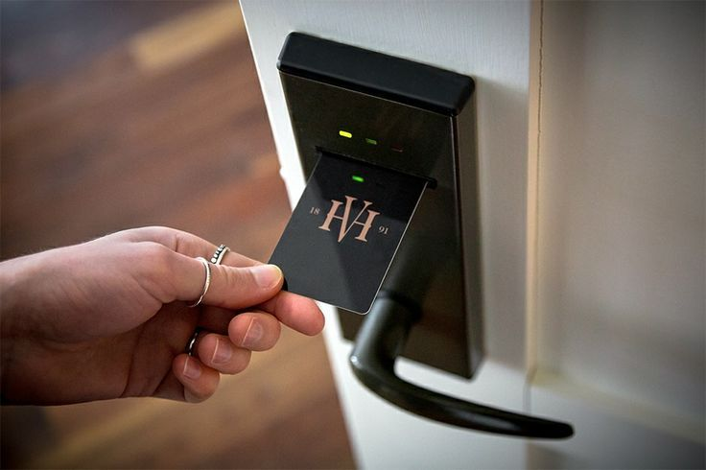
Vocabulary & Phrases
Repeat after the Speaker
key card（門卡）
Nowadays, most hotels use key cards instead of keys to get into hotel rooms.

Slide 22

Vocabulary & Phrases
Repeat after the Speaker
porter（行李員）
We can ask the porter to carry the luggage to our room.

Slide 23
Lesson 4: I’d Like to Check In
This is the end of Lesson 4,
Part 2.

