Slide 1


運動專業英語
English for Athletes

Slide 3
Lesson 4: I’d Like to Check In
Part 3: Mini Dialogues

Slide 4
Mini Dialogue 1
(the situation)
(Alex is talking to a clerk on the phone in a hotel room.)

Slide 5
Mini Dialogue 1
Clerk: Good morning, Sir. What
can I do for you?
Alex: Could you send someone up
for my laundry, please?
Clerk: Certainly, Mr. Parks. A valet
will be up in a few minutes.
Alex: Thank you.

Slide 6
Mini Dialogue 2
(the situation)
(Eric is having lunch in a restaurant. And he is making a request to a waitress.)

Slide 7
Mini Dialogue 2
Eric: Miss.
Waitress: Yes, what can I do for
you?
Eric: I’d like some more butter,
please.
Waitress: Certainly.

Slide 8
Mini Dialogue 3
(the situation)
(Judy is in a fast food restaurant. She is ordering.)
Clerk: May I take your order?
Judy: Yes, I’d like a hamburger, a
diet coke, and a salad, please.

Slide 9
Mini Dialogue 3
Clerk: Ok. One hamburger, one
diet coke, and one salad.
Anything else?
Judy: No, that’s all.
Clerk: For here or to go?
Judy: To go.

Slide 10
Mini Dialogue 3
Clerk: All right. That will be four
dollars and eighty cents.
Judy: Here you go.
Clerk: Thank you. Here’s your
change. Enjoy your meal.

Slide 11
Mini Dialogues – Vocabulary & Phrases
laundry（洗衣）
valet（僕從）
request（請求）
order（訂購）
for here（內用）
to go（外帶）
cent（一分錢，美、加等國的貨幣單位）

Slide 12
Mini Dialogues – Vocabulary & Phrases
Repeat after the Speaker
laundry（洗衣）
valet（僕從）
request（請求）
order（訂購）
for here（內用）
to go（外帶）
cent（一分錢，美、加等國的貨幣單位）

Slide 13
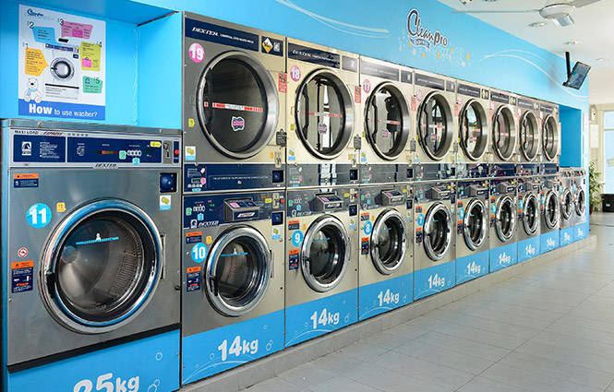
Vocabulary & Phrases—Practice
Repeat after the Speaker
laundry （洗衣）
The hotel has a laundry service for guests.

Slide 14
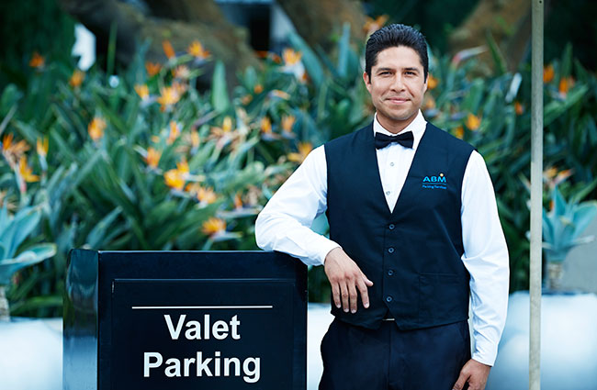
Vocabulary & Phrases—Practice
Repeat after the Speaker
valet（僕從）
I don’t need a valet to help me.

Slide 15
Vocabulary & Phrases—Practice
Repeat after the Speaker
request（請求）
My request for time off work was denied.
order（訂購）
I would like to place my order for dinner.

Slide 16
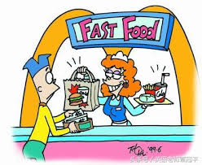
Vocabulary & Phrases—Practice
Repeat after the Speaker
for here（內用）
to go（外帶）
Is that for here or
to go?

Slide 17
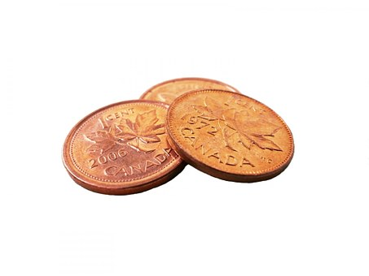
Vocabulary & Phrases—Practice
Repeat after the Speaker
cent（一分錢，美、加等國的貨幣單位）
The newspaper costs 50 cents .

Slide 18
Word Power

Slide 19
Word Power

Slide 20
運動專業英語
English for Athletes
Lesson 4: I’d Like to Check In
This is the end of Lesson 4,
Part 3.

