Slide 1


運動專業英語
English for Athletes

Slide 3
Lesson 4:I’d Like to Check In
Part 4: Practice

Slide 4
Useful Expressions
Repeat after the Speaker
May I help you? (需要幫忙嗎?)
Here you go. (在這裡)（應對方要求拿東西給別人時）
Which one do you prefer? (你比較喜歡哪一個？)
Is this all right? (這樣可以嗎？)
I’d like some more water. (我還要一些水)

Slide 5
Communicative Functions I
在旅館請求幫助
Customer | Front Desk
Could I have a card with the hotel’s address on it? | Sure, here you go.
Is hot water available anytime? | Yes, it is.
What time is breakfast served? | From 7:00 to 10:30 a.m.
What time should we check out? | Before 12:00 p.m.
I would like a wake-up call at 8:00 a.m. | No problem.

Slide 6
Communicative Functions II
詢問用餐資訊
Traveler | Response
Are there any good restaurants around here? | Yes, go straight along this road, and you’ll see some.
Is there a Chinese restaurant nearby? | Yes, go two blocks and turn right.
I’d like to have some local food? | You should try Uncle Pan’s.

Slide 7
Communicative Functions III
在餐廳提出詢問或請求
Customer | Waiter
Is this seat taken? | 1. No. Please have a seat. 2. Sorry, it’s taken.
My order hasn’t come yet. | Sorry, I’ll go check.
Could you bring me some ice? | Sure. Coming right up.

Slide 8
Gapped Conversation 1
(Jessie is trying to book a room by phone.)
Front Desk: Grand Hotel. May I
help you?
Jessie: I’d like to book a room.
Front Desk: Would you like a single
room or a double room?
Jessie: I need _________, please.

Slide 9
Gapped Conversation 1
(Jessie is trying to book a room by phone.)
Front Desk: Grand Hotel. May I
help you?
Jessie: I’d like to book a room.
Front Desk: Would you like a single
room or a double room?
Jessie: I need a double room, please.

Slide 10
Gapped Conversation 1
Front Desk: May I have your name,
please?
Jessie: It’s ________. And I’ll be
arriving on ________.

Slide 11
Gapped Conversation 1
Front Desk: May I have your name,
please?
Jessie: It’s Jessie Lai. And I’ll be
arriving on Thursday, May 2nd.

Slide 12
Gapped Conversation 1
Front Desk: Thank you. We’ll be
waiting to serve you.
Jessie: Thanks for your help.
Goodbye.

Slide 13
Gapped Conversation 2
(Becky has just arrived at the hotel. She is checking in.)
Becky: I’d like to check in.
Front Desk: Yes. May I have your
name, please?
Becky: Yes. It’s_______________.

Slide 14
Gapped Conversation 2
(Becky has just arrived at the hotel. She is checking in.)
Becky: I’d like to check in.
Front Desk: Yes. May I have your
name, please?
Becky: Yes. It’s Becky Chung.

Slide 15
Gapped Conversation 2
Front Desk: Your reservation is for
a _______ room for _______
night(s).
Becky: Yes.

Slide 16
Gapped Conversation 2
Front Desk: Your reservation is for
a quad room for three nights.
Becky: Yes.

Slide 17
Gapped Conversation 2
Front Desk: Thank you. Would you
like to pay by cash or credit card?
Becky: By _________.

Slide 18
Gapped Conversation 2
Front Desk: Thank you. Would you
like to pay by cash or credit card?
Becky: By credit card.

Slide 19
Gapped Conversation 2
Front Desk: May I have your ____,
please?
Becky: Here you are.

Slide 20
Gapped Conversation 2
Front Desk: May I have your card,
please?
Becky: Here you are.

Slide 21
Gapped Conversation 2
Front Desk: Here are your ______. Enjoy your stay with us.
Becky: Thank you very much.

Slide 22
Gapped Conversation 2
Front Desk: Here are your key
cards. Enjoy your stay with us.
Becky: Thank you very much.

Slide 23
Practice
根據以下圖片，輪流擔任服務生及顧客，進行點餐的活動.

Slide 24
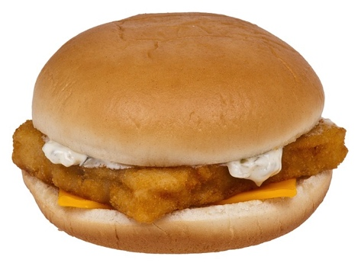

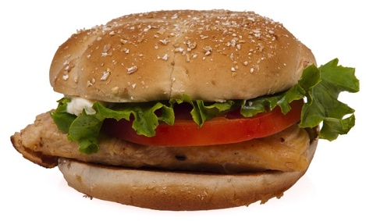
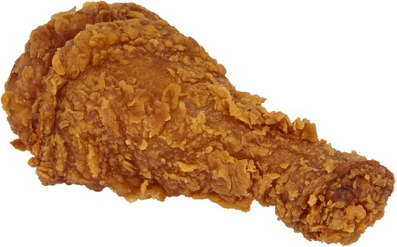
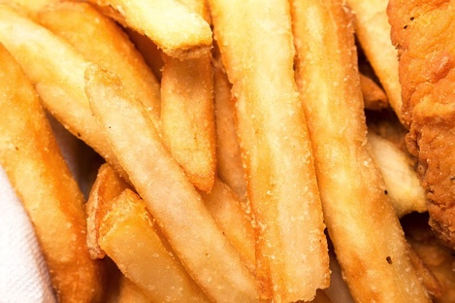
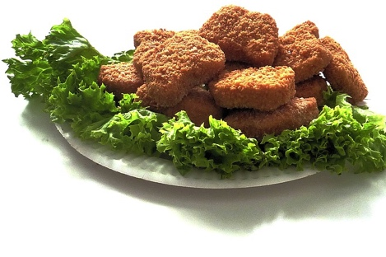

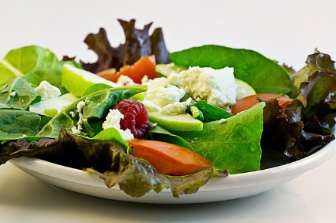
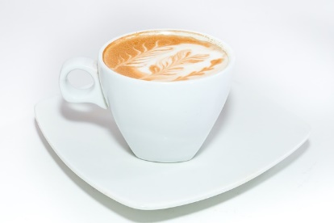

chicken burger $2.50
hamburger $2.00
fish burger $2.00
fried chicken $2.75
French fries $1.75
chicken nuggets $2.75
salad $1.75
coke $1.25
coffee $1.75
corn chowder $1.75

Slide 25
Practice
Clerk: May I take your order?
Keith: Yes, I’d like _______, please.
Clerk: OK. ______________.
Anything else?
Keith: No, that’s all.

Slide 26
Practice
Clerk: For here or to go?
Keith:_______.
Clerk: All right. That will be______
in total.
Keith: Here you go.
Clerk: Thank you. Here’s your
change. Enjoy your meal.

Slide 27
chicken burger $2.50
hamburger $2.00
fish burger $2.00
fried chicken $2.75
French fries $1.75
chicken nuggets $2.75
salad $1.75
coke $1.25
coffee $1.75
corn chowder $1.75

Slide 28
Practice
Clerk: May I take your order?
Keith: Yes, I’d like _______, please.
Clerk: OK. ______________.
Anything else?
Keith: No, that’s all.

Slide 29
Practice
Clerk: For here or to go?
Keith:_______.
Clerk: All right. That will be______
in total.
Keith: Here you go.
Clerk: Thank you. Here’s your
change. Enjoy your meal.

Slide 30
Lesson 4: I’d Like to Check In
This is the end of Lesson 4,
Part 4.

